Slide 1
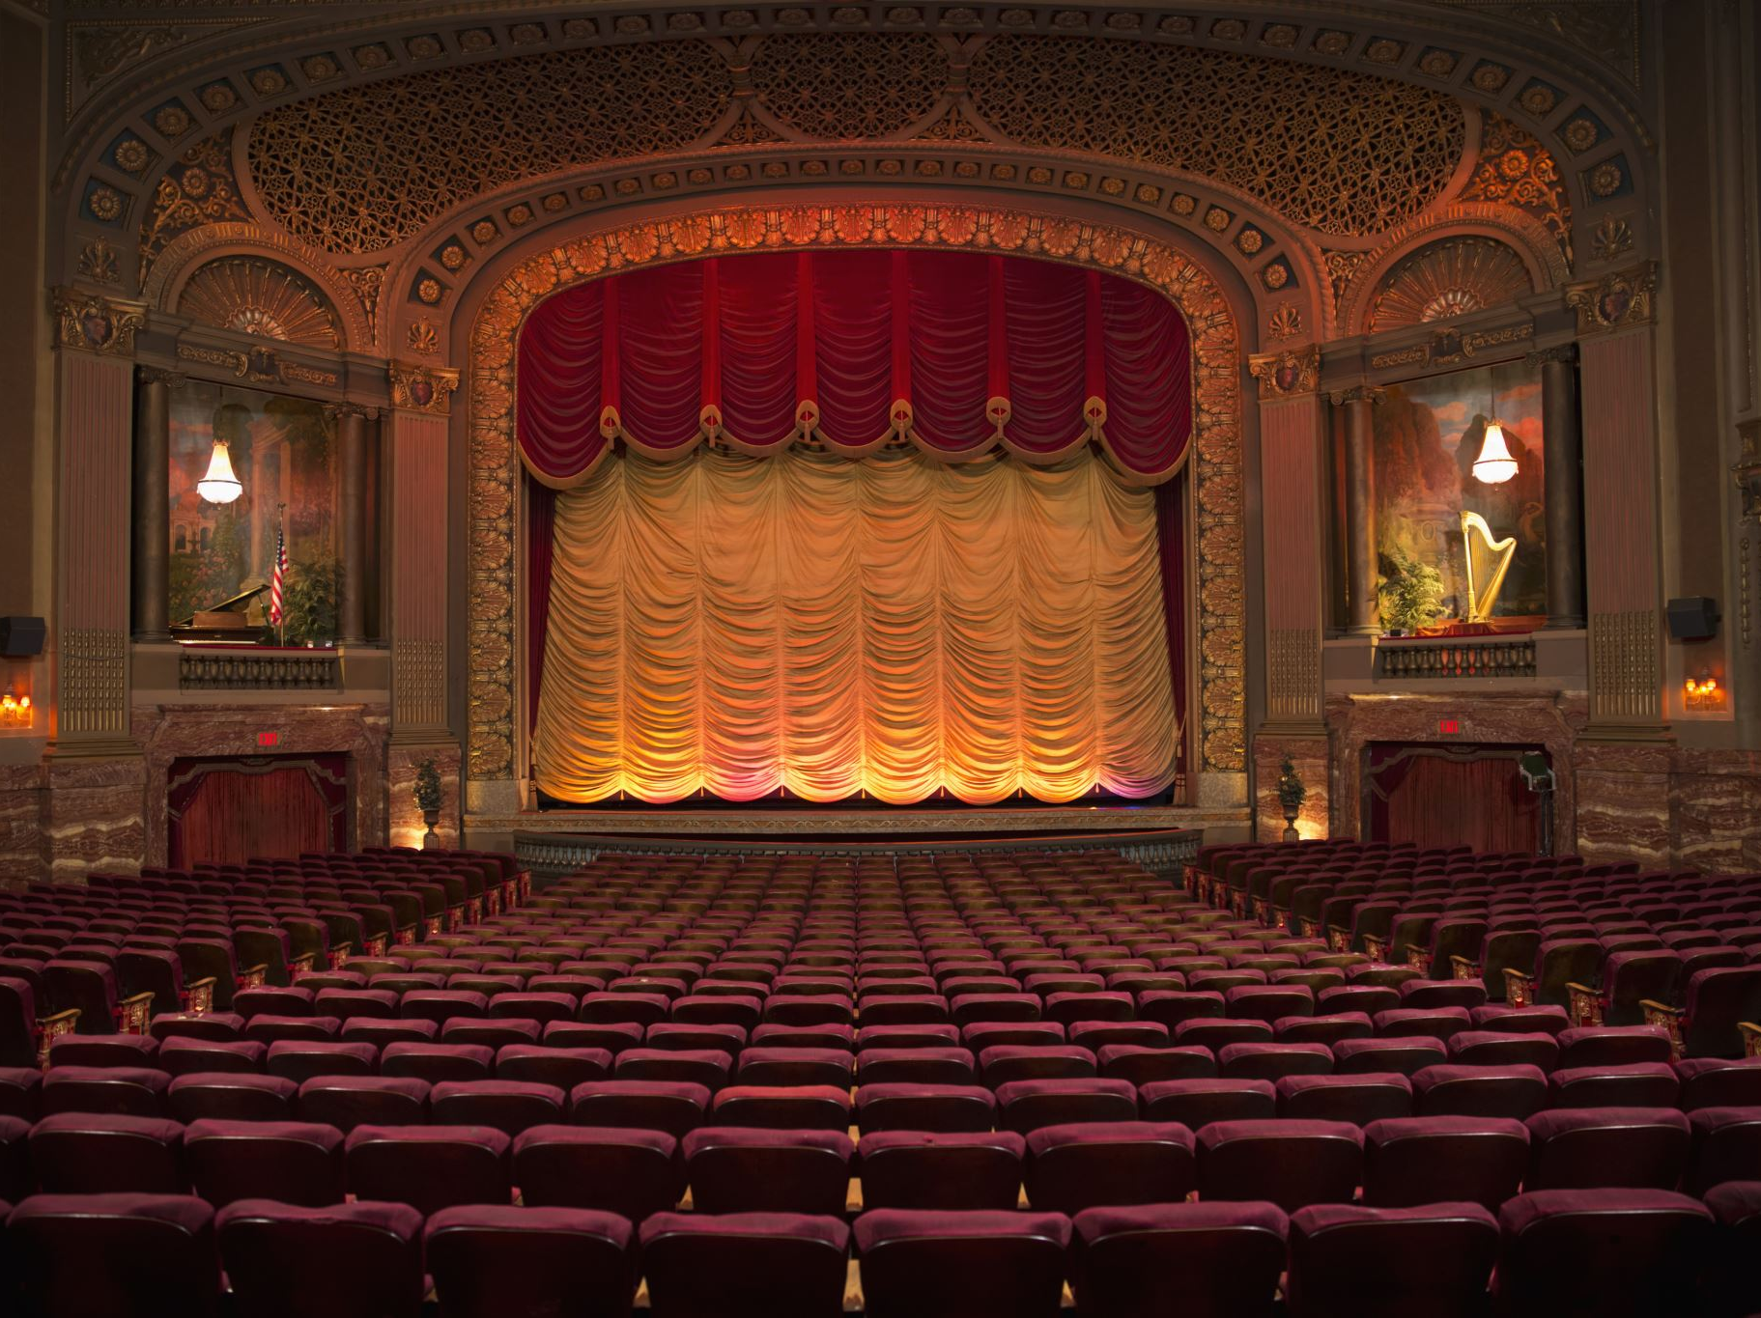
Contemporary British Drama

Slide 2

What is Contemporary British Drama?
• Drama written and performed mainly after World War II
• Reflects modern social, political, and cultural realities
• Deals with identity, class, gender, race, alienation, and power
• Experiments with dramatic techniques and stagecraft

Slide 3

Historical Background
• Post-war Britain and social reconstruction
• Decline of the British Empire
• Rise of welfare state and urbanization
• Influence of modernism and postmodernism
• Theatre as a medium of protest and realism

Slide 4
Major Features
• Social realism
• Political criticism
• Psychological conflict
• Fragmented narratives
• Black humour and satire
• Experimental staging

Slide 5
The Angry Young Men
• Literary movement of the 1950s
• Expressed frustration of the middle and working classes
• Criticized class system and social hypocrisy
• Important playwright: John Osborne

Slide 6
John Osborne and Look Back in Anger
• Published in 1956
• Revolutionized British theatre
• Hero Jimmy Porter represents post-war anger
• Themes: frustration, class conflict, disillusionment

Slide 7
Harold Pinter
• Known for the ‘Comedy of Menace’
• Use of silence, pauses, and ambiguity
• Themes of power and human insecurity
• Famous works: The Birthday Party, The Caretaker

Slide 8
Tom Stoppard
• Combines philosophy, wit, and intellectual comedy
• Influenced by absurd theatre
• Famous work: Rosencrantz and Guildenstern Are Dead
• Explores uncertainty and identity

Slide 9
Caryl Churchill
• Feminist and experimental playwright
• Challenges gender roles and capitalism
• Famous works: Top Girls, Cloud Nine
• Uses non-linear structure and role-switching

Slide 10
Sarah Kane and In-Yer-Face Theatre
• Radical theatre movement of the 1990s
• Directly shocks and confronts the audience
• Themes: violence, trauma, mental illness
• Important plays: Blasted, 4.48 Psychosis

Slide 11
Postmodern Elements
• Fragmented structure
• Mixing of genres and styles
• Intertextuality and parody
• Breaking the fourth wall
• Open-ended conclusions

Slide 12
Themes in Contemporary British Drama
• Identity and alienation
• Gender and sexuality
• Class struggle
• Racism and multiculturalism
• Politics and power

Slide 13
Stagecraft and Techniques
• Minimalist stage design
• Symbolic lighting and sound
• Use of pauses and silence
• Multimedia and visual effects
• Audience interaction

Slide 14
Impact and Significance
• Revitalized modern theatre
• Encouraged social awareness
• Expanded dramatic experimentation
• Influenced world theatre and performance studies

Slide 15
Conclusion
• Contemporary British drama reflects modern society and its conflicts
• It combines realism, experimentation, and political critique
• Continues to evolve with changing cultural realities

