Slide 1

Irish Theatre

Slide 2

Introduction to Irish Theatre
Irish theatre reflects the social, political, and cultural life of Ireland.
Strong connections with nationalism, folklore, and identity.
Developed prominently during the late 19th and early 20th centuries.

Slide 3

Historical Background
Irish theatre emerged during the Irish Literary Revival.
The movement aimed to revive Irish culture and traditions.
Theatre became a tool of cultural nationalism.

Slide 4
The Irish Literary Revival
Also called the Celtic Revival.
Encouraged interest in Irish myths, legends, and folklore.
Major figures: W. B. Yeats, Lady Gregory, J. M. Synge.

Slide 5

The Abbey Theatre
Founded in 1904 in Dublin.
Established by W. B. Yeats and Lady Gregory.
Known as Ireland’s National Theatre.
Promoted Irish drama and playwrights.

Slide 6
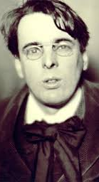
W. B. Yeats
Poet, dramatist, and Nobel Prize winner.
Combined symbolism and Irish mythology.
Important plays: 'Cathleen ni Houlihan’,
'The Countess Cathleen'.

Slide 7
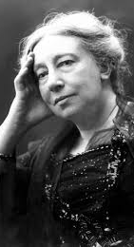
Lady Gregory
Co-founder of the Abbey Theatre.
Collected Irish folk tales and legends.
Important plays: 'Spreading the News', 'The Rising of the Moon'.

Slide 8
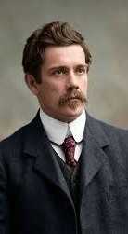
J. M. Synge
Known for realistic portrayal of Irish rural life.
Used poetic language and humour.
Famous play: 'The Playboy of the Western World'.

Slide 9
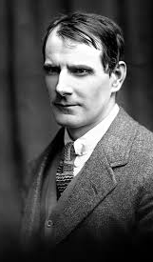
Sean O’Casey
Focused on Dublin’s working-class life.
Combined tragedy and comedy.
Major plays: 'Juno and the Paycock', 'The Plough and the Stars'.

Slide 10
Characteristics of
Irish Theatre
Use of Irish folklore and mythology.
Themes of nationalism and identity.
Blend of realism, symbolism, and humour.
Rich poetic language and dialogue.

Slide 11
Irish Theatre and Politics
Closely linked with Irish nationalism.
Plays often reflected colonial oppression and social struggles.
Theatre became a medium for political expression.

Slide 12
Modern Irish Theatre
Expanded after independence.
Modern playwrights include Samuel Beckett and Brian Friel.
Themes became more experimental and universal.

Slide 13
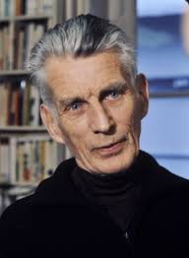
Samuel Beckett
Major dramatist associated with the Theatre of the Absurd.
Famous play: 'Waiting for Godot'.
Explored themes of existentialism and meaninglessness.

Slide 14
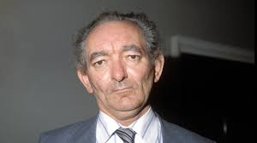
Brian Friel
Known for memory, language, and identity themes.
Important plays: 'Translations', 'Dancing at Lughnasa'.

Slide 15

Impact and Legacy
Irish theatre influenced world drama significantly.
The Abbey Theatre remains globally respected.
Irish playwrights continue to shape modern theatre.

Slide 16
Conclusion
Irish theatre combines culture, politics, folklore, and artistic innovation.
It remains an important part of English literature and drama studies.
Its legacy continues in contemporary theatre worldwide.

