Slide 1
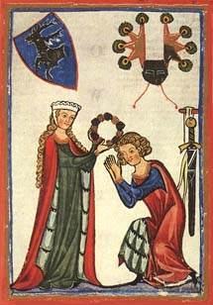
Courtly Love
Courtly love is a medieval European literary concept, which originated in the aristocratic courts of France and became influential in English literature during the Middle Ages and the Renaissance.

Slide 2

Courtly Love
It refers to a set of ideals and practices governing the conduct of noble lovers, particularly focusing on the love between a knight and a noblewoman. This love was often idealized, secret, and chivalric, reflecting the social and moral codes of the time.

Slide 3
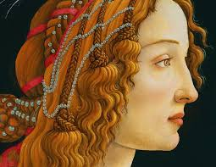
Idealization of the Lady
In courtly love, the woman is seen as unattainable, both because of her high social standing and often her existing marital status. She is typically placed on a pedestal, and the knight's love for her transcends physical desire, becoming more about service and loyalty.

Slide 4
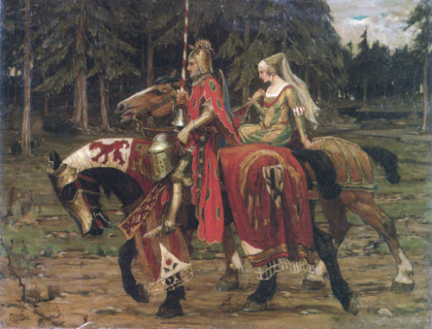
Chivalric Code and Duty
The knight, bound by a chivalric code, must demonstrate virtues like courage, humility, and loyalty. His love for the lady compels him to perform noble deeds, such as fighting in tournaments, embarking on quests, or protecting the weak. This is not just to win her favour, but as a demonstration of his worthiness.

Slide 5

Unrequited or Secret Love
In courtly love narratives, the love remains unrequited or unfulfilled, often due to social barriers such as the woman being married or otherwise unavailable. The knight’s feelings are typically kept secret, or if known, they are expressed in a way that respects the societal conventions of the time. The longing for the beloved and the inability to fully possess her is central to the experience of courtly love.

