Slide 1

The Norman Conquest (1066)

Slide 2
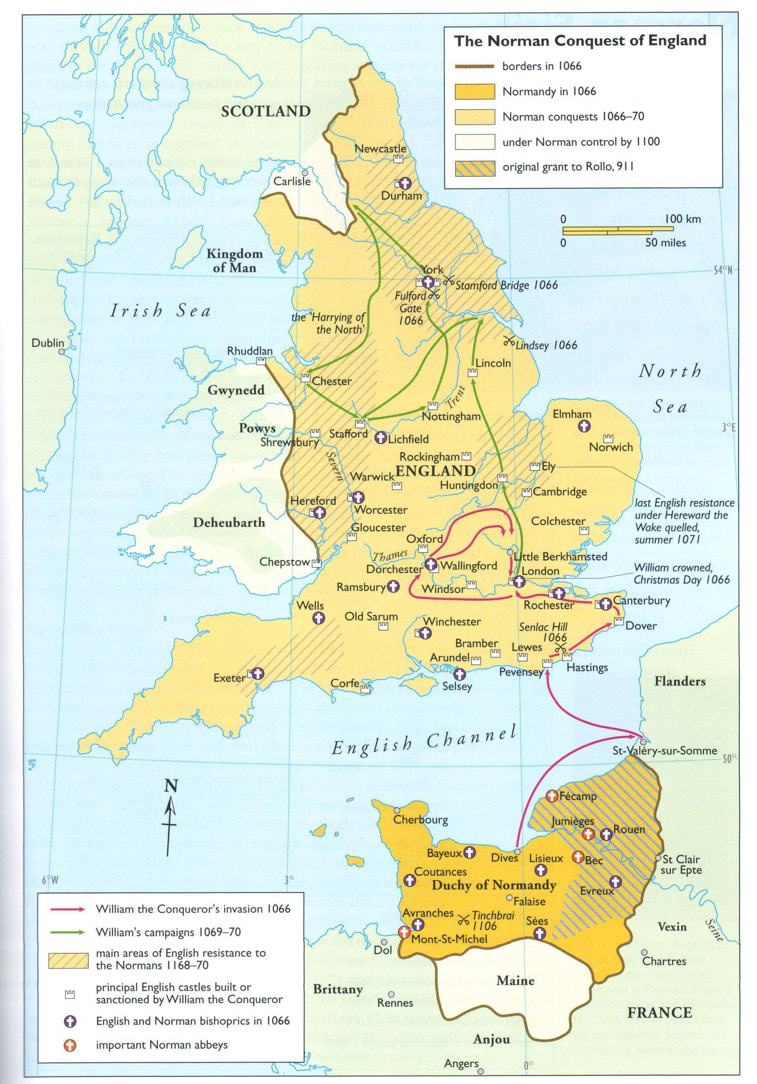

Slide 3
Introduction
The Norman Conquest refers to the invasion and occupation of England by the Normans in 1066.
Led by William, Duke of Normandy, later known as William the Conqueror.
One of the most significant events in English history.

Slide 4

Background
Edward the Confessor, King of England, died in January 1066 without an heir.
Three claimants to the throne: Harold Godwinson, William of Normandy, Harald Hardrada.
Led to conflict over succession.

Slide 5

The Battle of Hastings
Fought on 14 October 1066 between the Norman-French army and the English army.
William defeated King Harold II, who was killed in the battle.
The Normans used cavalry, archers, and disciplined infantry effectively.

Slide 6

William Becomes King
William crowned King of England on 25 December 1066.
Brought Norman culture, governance, and language to England.
Strengthened royal authority and feudal system.

Slide 7

Consequences of the Norman Conquest
Introduction of Norman French into English language, influencing vocabulary.
Change in English aristocracy; land redistributed to Norman nobles.
Castles built across England for control and defence.
Doomsday Book commissioned to record land and resources.

Slide 8


Cultural and Literary Impact
Old English began to merge with Norman French, evolving into Middle English.
Literature saw new themes, styles, and courtly traditions.
Latin remained dominant in official and church records.

Slide 9


Summary
The Norman Conquest was a turning point in English history.
It reshaped England’s political system, language, and culture.
Its effects can still be seen in modern English society and vocabulary.

