Slide 1
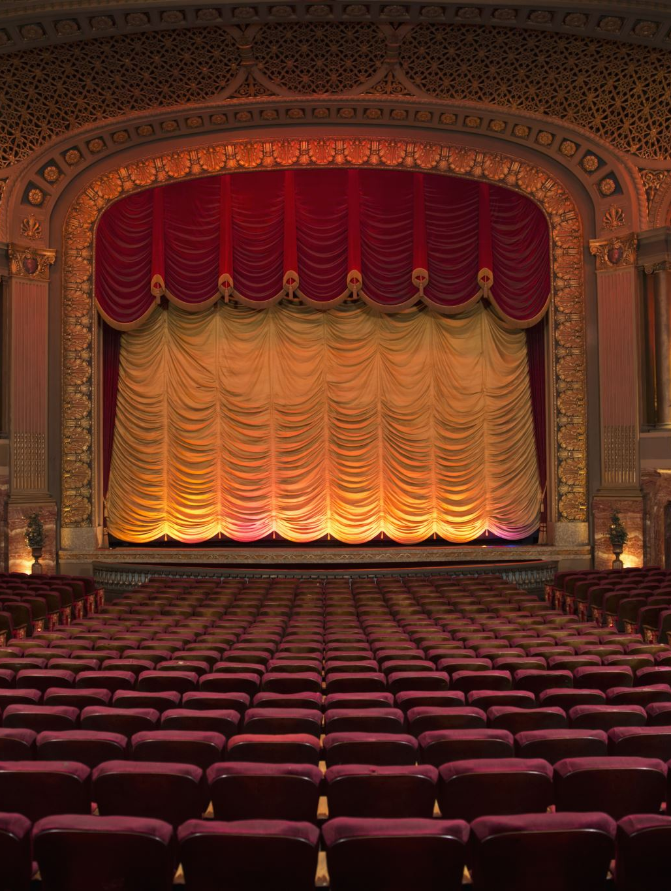
The Role of Chorus in Drama
Understanding its Function and Significance

Slide 2
What is a Chorus?
The chorus is a group of performers who comment on the main action of the play.
Originated in Ancient Greek theatre, especially in tragedies.
Functions as a bridge between the audience and the play’s characters.

Slide 3
Historical Background
Greek Drama: Chorus played a central role in tragedies by Aeschylus, Sophocles, and Euripides.
Roman Drama: Reduced role, focusing more on individual actors.
Elizabethan Drama: Found in plays like Shakespeare’s Henry V.
Modern Drama: Occasionally used in experimental and symbolic theatre.

Slide 4

Functions of the Chorus
1. Commentary: Provides background information and context.
2. Moral Guide: Reflects on ethical aspects of the play’s events.
3. Foreshadowing: Hints at future developments.
4. Relief: Sometimes provides comic relief in tragic plays.
5. Bridge to Audience: Helps the audience connect emotionally with the story.

Slide 5

The Chorus in Greek Tragedy
Often consisted of 12-15 members.
Delivered lines in unison, sometimes with music and dance.
Represented the collective voice of society or the gods.
Example: In Oedipus Rex, the chorus expresses the fears and hopes of Thebes.

Slide 6
The Chorus in Shakespearean Drama
Used sparingly but effectively.
Often appears as a single narrator rather than a group.
Example: Henry V – The Chorus sets the scene and asks the audience to use their imagination.
Example: Romeo and Juliet – The Chorus delivers the Prologue, summarizing the tragedy.

Slide 7
The Chorus in Modern Drama
Rare but used innovatively in contemporary plays.
Example: Murder in the Cathedral (T.S. Eliot) – The Chorus represents the women of Canterbury.
Example: An Inspector Calls (J.B. Priestley) – While no traditional chorus exists, the Inspector serves a similar role by guiding the moral discussion.

Slide 8

Conclusion
The chorus has evolved over time but remains a powerful dramatic device.
It provides insight, commentary, and emotional depth to plays.
Even in modern theatre, elements of the chorus continue to influence storytelling techniques.

