Slide 1
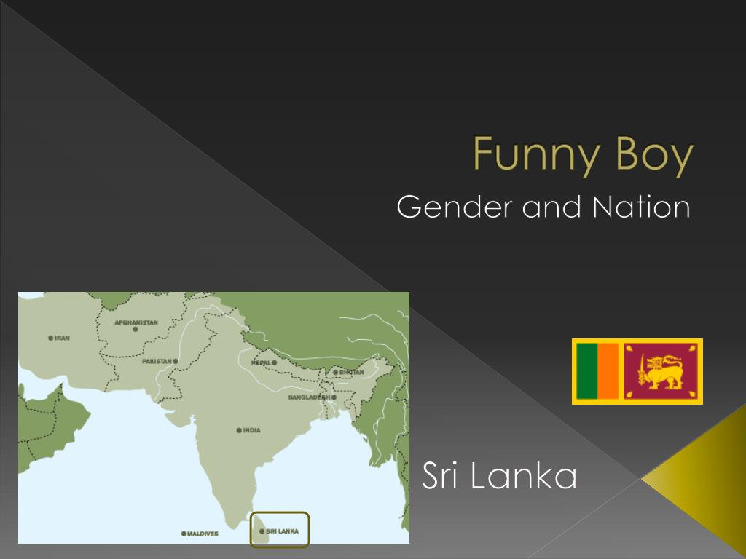
Funny Boy
Shyam Selvadurai (Sri Lankan-Canadian author)

Slide 2
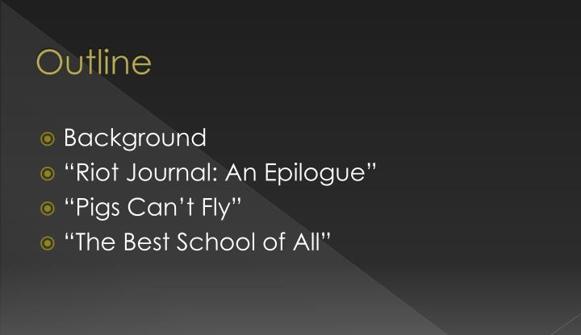

Slide 3
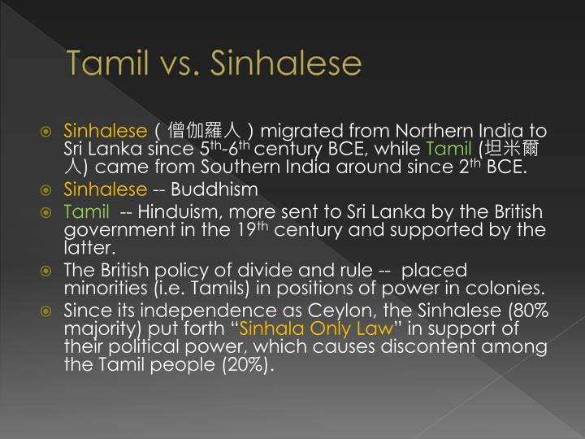

Slide 4

Funny Boy – set against the increasing violence between a between Sinhalese and Tamil in Sri Lank, culminating in the civil war which lasted for almost a decade(1983-1991).
• Black July, 1983: between 400-3000 Tamils were killed, tens of thousands of houses were destroyed, and a wave of Sri Lankan Tamils left for other countries. (source)

Slide 5
The author Shyam Selvadurai and his family are forced into exile after the 1983 racial riot against the Tamil in Colombo.
• The protagonist, "Arjie" Chelvaratnam, is the second-son of a privileged middle-class Tamil family in Colombo.

Slide 6
• Sinhalese migrated from Northern India to Sri Lanka since 5th-6th century BCE, while Tamil came from Southern India around since 2th BCE.
• Sinhalese -- Buddhism
•Tamil -- Hinduism, more sent to Sri Lanka by the British government in the 19th century and supported by the latter.

Slide 7
The British policy of divide and rule -- placed minorities (i.e. Tamils) in positions of power in colonies.
• Since its independence as Ceylon, the Sinhalese (80% majority) put forth “Sinhala Only Law” in support of their political power, which causes discontent among the Tamil people (20%).

Slide 8
Funny Boy :Connected stories of how Arjie is continually isolated from his family and then exiled from his society because of his gender orientation and the society’s racial tensions and despite attempts at breaking boundaries and rebellion.
• "Pigs Can't Fly-- Arjie's early childhood and his gravitation towards the imaginative games his female cousins play as opposed to his male cousins' beloved game of cricket.
• "Radha Aunty" --Arjie's Aunt Radha, and her doomed affair with a Sinhalese man.

Slide 9

Funny Boy—CHAPTERS
Pigs Can't Fly:
Radha Aunty:
See No Evil, Hear No Evil:
Small Choices:
The Best School of All:
Riot Journal: An Epilogue:

Slide 10
Pigs Can't Fly
The first part of the novel begins with the spend-the-days, in which the grandchildren congregate at Ammachi and Appachi's home. Arjie and his female cousins, as usual, play their game of "bride-bride", which is interrupted when their cousin Tanuja (Her Fatness) refuses to indulge Arjie's desire to be bride. The adults ultimately discover their game, and one uncle tells Arjie's father "you have a funny one here" (14). Arjie is no longer allowed to play with the girls. When he questions his mother, she responds with "because the sky is so high and pigs can't fly, that's why"

Slide 11
Radha Aunty
The second chapter focuses on the return of Radha Aunty from America. Radha Aunty and Arjie develop a special relationship, immediately, and both become involved in a performance of The King and I. Although she receives an engagement offer from Rajan Nagendra, she is reluctant and develops a friendship with Anil Jayasinghe, a Sinhalese who is also involved in the play. The extended family warns Radha and encourages her to put an end to the relationship. Radha Aunty goes to Jaffna to forget about Anil, and on her return journey, she and other Tamils are attacked on the train. Eventually, she becomes engaged to Rajan. It is through the friendship between his aunt and Anil that Arjie begins to understand the concept of ethnicity and the Tamil-Sinhalese conflict.

Slide 12
See No Evil, Hear No Evil
In the third story, while Arjie's father is in Europe on a business trip, Daryl Uncle returns to Sri Lanka from Australia to investigate allegations of government torture. Arjie is cognizant of a long history between Amma and Daryl Uncle but is unsure of the cause of the tensions until he has an eventual realization of their affair. When Arjie becomes very ill, Amma decides to take Arjie from Colombo to the countryside to recover. Much to Arjie's surprise, Daryl Uncle visits Arjie and his mother throughout their stay in the hill country. Following his recovery, Arjie and Amma return to Colombo, while Daryl Uncle goes to Jaffna. When there is news that violence had broken out in Jaffna, Amma becomes worried about Daryl and eventually, they receive word that Daryl's body was found on the beach, supposedly from drowning but they suspect he was killed first. Although Amma tries to pursue the matter further, a civil rights lawyer tells her that there is nothing they can do, given the state of the country, and that "one must be like the three wise monkeys. See no evil, hear no evil, speak no evil" (141).

Slide 13
Small Choices
In a plot shift, Appa's school friend's son Jegan comes to the family looking for a job and begins to work with Appa at his hotel and also lives with the Chelvaratnam family at their home. Jegan previously associated with the Tamil Tigers, but insists that he has broken all connections with the organization. Jegan also strikes up a friendship with Arjie and for the first time, Arjie feels his homosexual tendencies surface, as Arjie admires "how built he was, the way his thighs pressed against his trousers." The Tamil-Sinhalese tensions build up throughout the story, and Jegan is accused of being involved in a plot to assassinate a Tamil politician who the Tamil Tigers label as a traitor (177). After Jegan's room at the hotel is vandalized, Appa decides it is best to fire Jegan and he leaves with hints that he may retrace back to his violent past (200).

Slide 14
The Best School of All
Appa decides to transfer Arjie to Victoria Academy, a school he says "will force you to become a man" (210). Arjie catches the eye of a boy named Shehan as well as the notorious school principal. Diggy hints that Shehan is gay and urges Arjie to stay away from him. Arjie notices in himself a growing attraction towards Shehan as the two spend more time together. The principal, nicknamed "Black Tie" ropes in Arjie to recite two poems at an upcoming school function. The function and specific poems are especially important to "Black Tie" as they are his final plea to prevent the government from reorganizing the school. Arjie gets nervous reciting the poems and forgets his lines, and the principal beats Arjie as well as Shehan for failing to help him memorize the poems. One day, Shehan kisses Arjie on the lips and he recoils, but it is after the kiss Arjie begins to comprehend his own sexuality. "I now knew that kiss was somehow connected to what we had in common, and Shehan had known this all along" (250), he says. Later, Arjie and Shehan have their first sexual encounter together in his parents' garage. Afterwards, Arjie feels ashamed of himself and believes he has failed his family and their trust. During the school function, Arjie purposely jumbles up his poem after he witnesses Shehan emotionally break down from Black Tie's beatings.

Slide 15
Riot Journal: An Epilogue
In the final chapter of the novel, rioters start to burn down the Tamil houses and establishments in Colombo. The family escapes to a neighbor's house and goes into hiding after a mob comes to burn down their home. After their own hotel is attacked and Ammachi and Appachi are killed, Appa decides it is time for the family to leave the country. After making love to Shehan for the last time, Arjie leaves Sri Lanka and moves to Canada with his family.

