Slide 1

PLOT
IN
LITERATURE

Slide 2

PLOT
a literary term used to describe the basic action within a work of fiction.
• In a strongly plotted story, the events usually follow this pattern: a conflict or problem is established; complications arise from the conflict; a main character takes decisive action, or the situation itself brings about a climax; the conflict is resolved.
• Modern short stories and novels, however, frequently deviate from this outline. One of the most common is a non-plotted character sketch.

Slide 3
Structure of the action of a Story
In conventional stories, plot has three main parts:
rising action, climax, and falling action leading to a resolution or denouement (Harris & Hodges,1995).

Slide 4

TERMS USED TO DESCRIBE THE PLOT
﻿Exposition: describes some problem or trouble within the story. It frequently falls into one of the following categories: • man vs. man • man vs. himself • man vs. nature • man vs. society • man vs. supernatural
RISING ACTION •describes the introduction of the conflict and the resulting complications.
﻿CLIMAX •designates the moment of highest tension in the story. It represents the moment when the outcome is decided.
﻿FALLING ACTION •describes the falling off of intensity within the story.
﻿DENOUEMENT •is a French word used to describe the final resolution of details within the story. It is everything that occurs after the climax.

Slide 5
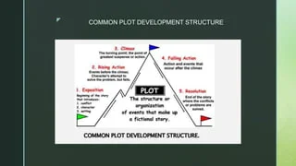
COMMON PLOT DEVELOPMENT STRUCTURE

Slide 6
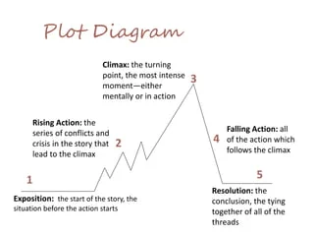

Slide 7

Types of Plots
There are four primary types of plots (modified from Anderson, 2006, & Lukens, 2007):
Linear - plot is constructed logically and not by coincidence.
Episodic - one incident or short episode is linked to another by common characters or a unified theme.
Cumulative - plots with lots of repetition of phrases, sentences, or events with one new aspect added with each repetition.
Circular - the characters in the story end up in the same place that they were at the beginning of the story.

Slide 8

Plot: Conflict
Conflict is the dramatic struggle between two forces in a story.
Without conflict, there is no plot!
Usually introduced during the rising action
Faced head-on during the climax
Begins to work itself out during the falling action
Is resolved during the resolution

Slide 9

Other Types of Conflict:
Character vs Supernatural (Gods, ghosts, monsters, spirits, aliens, etc)
Character vs Fate (Fight for choice; fight against destiny)
Character vs Technology
(Computers, machines, etc)

Slide 10
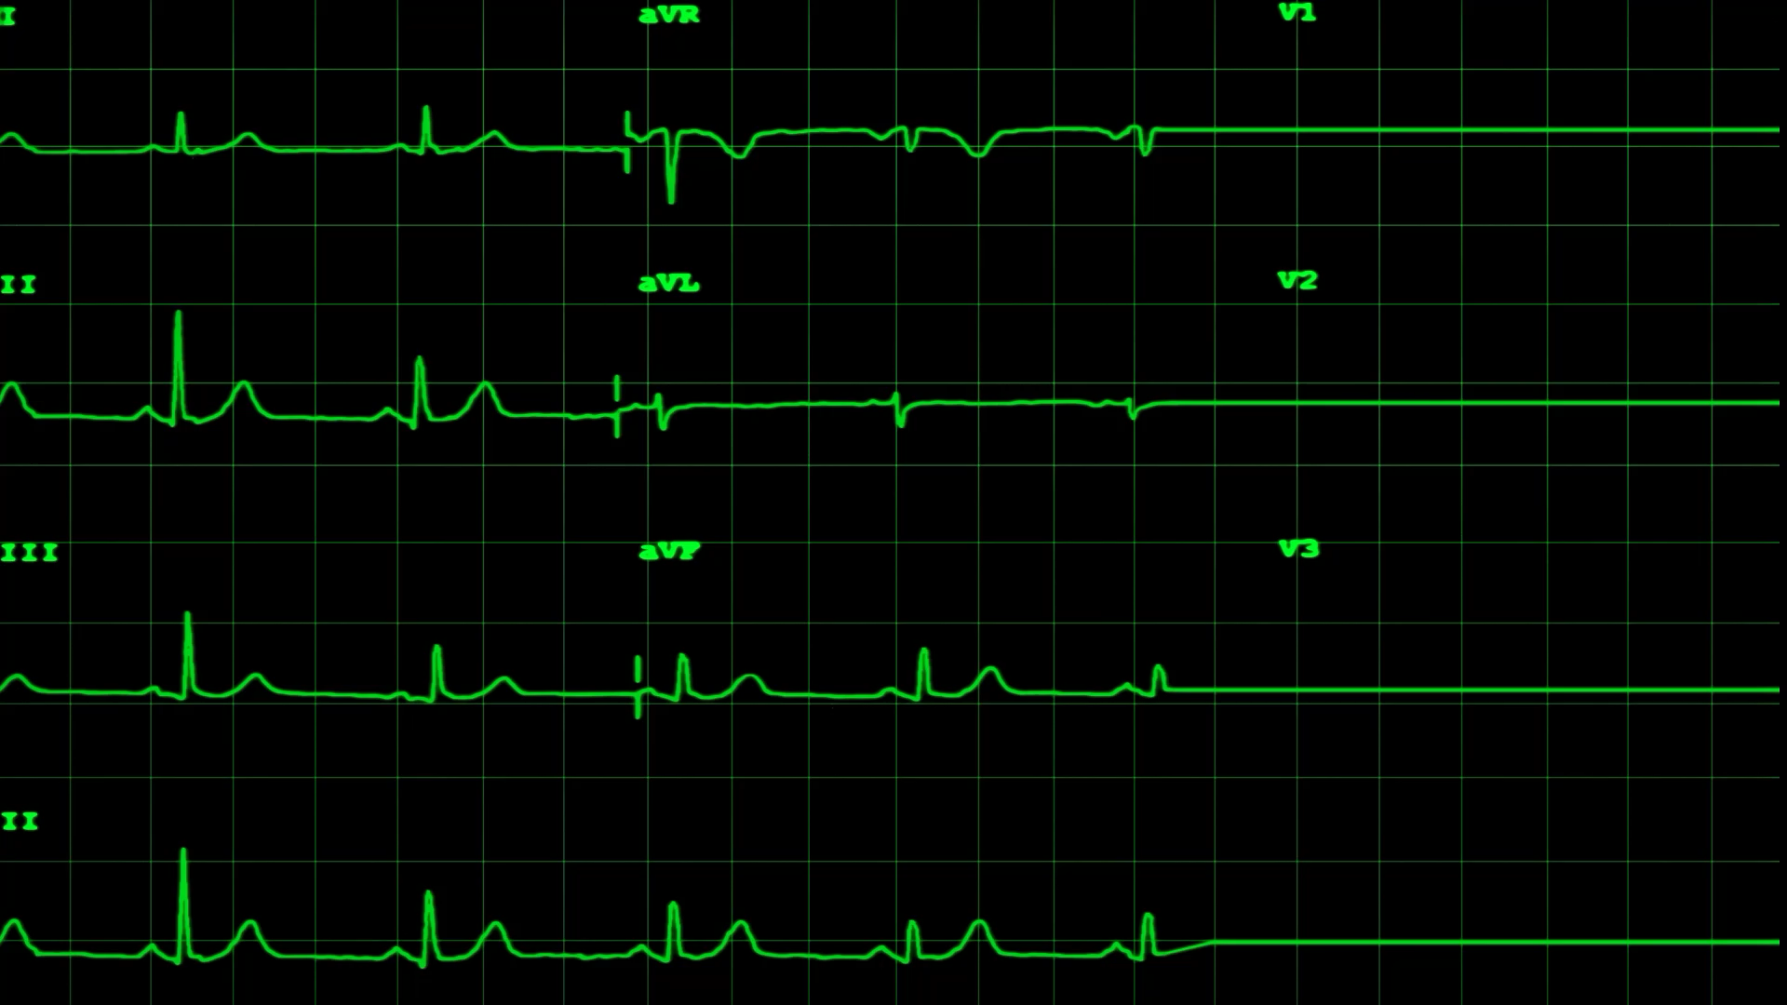
COMMON LITERARY TECHNIQUES IN PLOTS

Slide 11

FLASHBACK
FLASHBACK is a literary technique used to insert events out of the order of their occurrence within a story.

Slide 12

FORESHADOWING
FORESHADOWING is a method used to hint of events to come. It may be blatant or merely implied.

Slide 13

OPEN ENDED
OPEN ENDED STORIES have outcomes which leave the reader wondering about the outcome.

Slide 14

STREAM OF CONSCIOUSNESS
STREAM OF CONSCIOUSNESS a technique used to tell the story as it might be heard within a character's mind. It is frequently rambling and disjointed.

