Slide 1
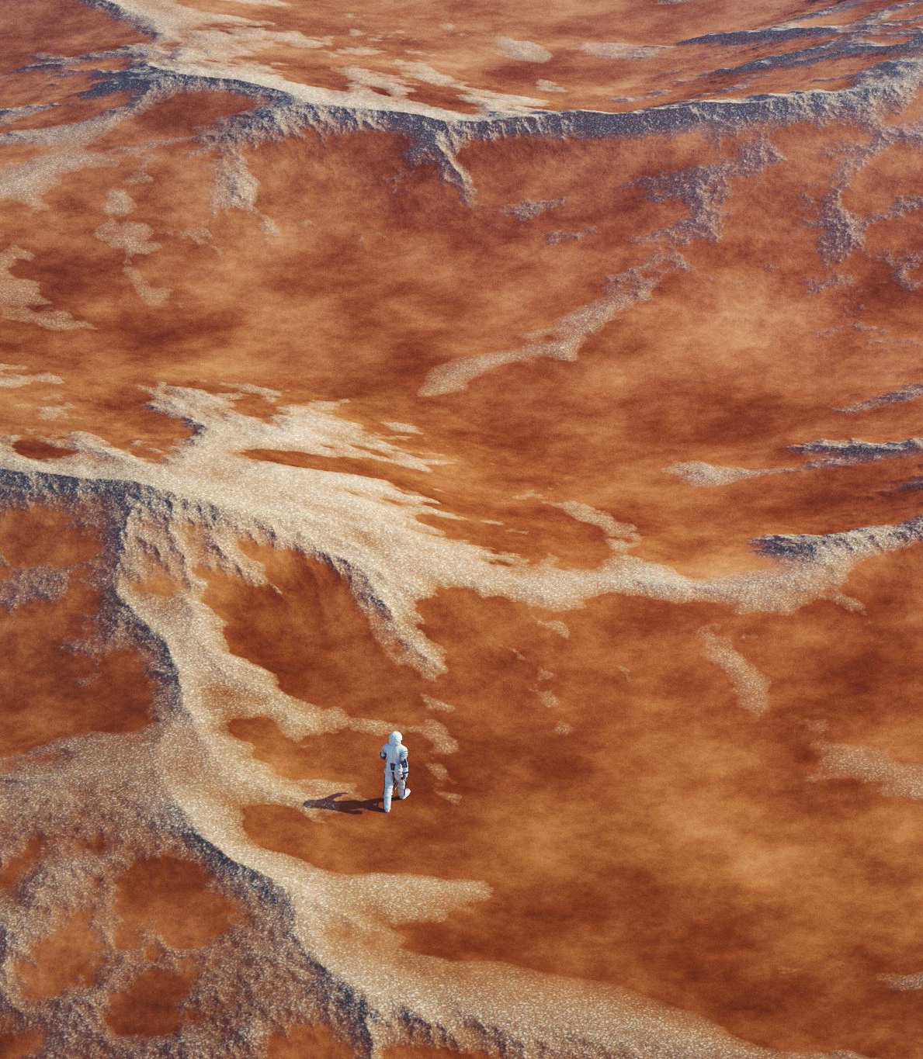
The Epic in English and the Western World

Slide 2

Introduction
What is an epic?
Definition of an epic.
Elements of epic.
Features of epic,
Examples of epic...etc

Slide 3

What is epic?
Epic is a poetic form of literature. The word epic is derived from the Ancient Greek adjective, "epikos", which means a poetic story.

Slide 4

Definition of Epic
A long narrative poem written in elevated style, in which heroes of great historical or legendary importance perform valorous deeds.

Slide 5
Features of
Epic
A long narrative poem
The theme of epic is sublime
The action is controlled by supernatural agents the classical God and Goddesses.

Slide 6
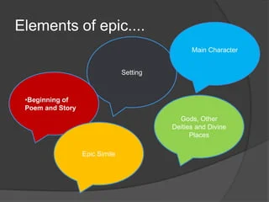

Slide 7
Beginning of Poem and Story
Epic poems begin with the narrator's statement of the poem's subject and his invocation to, or calling upon, a muse or other divine entity to assist him in taking on the task of telling his story.

Slide 8
Setting
The setting is vast in scope, covering great nations, the world, or the universe, and the action is important to the history of a nation or people

Slide 9
The Protagonist
An epic poem’s protagonist is a heroic figure who represents a particular culture's idea of what strengths and virtues make someone a hero. However, the epic hero's weaknesses and failings are as evident as his strengths and virtues.
Human and part god, and his actions can occur while on a journey or while pursuing a conquest.

Slide 10

Gods, Other Deities and Divine
• Gods and other deities often play a role in the outcome of events, whether for good or evil, as they assist the hero or become an obstacle in his quest.

Slide 11

Epic Simile
Epic poems often contain epic similes, which are long, highly descriptive similes that clarify the subject. Like a regular simile, the epic simile makes a comparison starting with "like" or "as

Slide 12
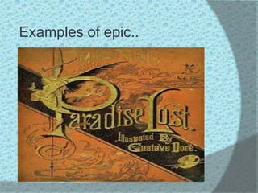

Slide 13
Other notable Western epics:
"The Aeneid" by Virgil: A Roman epic that tells the story of Aeneas, a Trojan hero who travels to Italy and becomes the ancestor of the Roman people.
Some other notable Western epics:
The Divine Comedy: by Dante Alighieri
The Faerie Queen: by Edmund Spenser
Don Quixote: by Miguel de Cervantes
War and Peace: by Leo Tolstoy (considered an epic novel)

Slide 14
In English and the Western world, an "epic" refers to a long narrative poem that tells the story of a heroic figure, often dealing with grand themes of courage, destiny, and the human condition, with famous examples including "The Iliad" and "The Odyssey" by Homer, "Beowulf" (Old English), "The Aeneid" by Virgil, and "Paradise Lost" by John Milton.

Slide 15
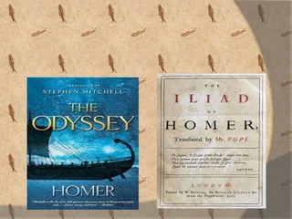

Slide 16
THANK YOU

