Slide 1

MYSTERY
AND
MORALITY PLAYS
an intervening episode, period, space, etc. a short dramatic piece, especially of a light or farcical character, formerly introduced between the parts or acts of miracle and morality plays or given as part of other entertainments.

Slide 2
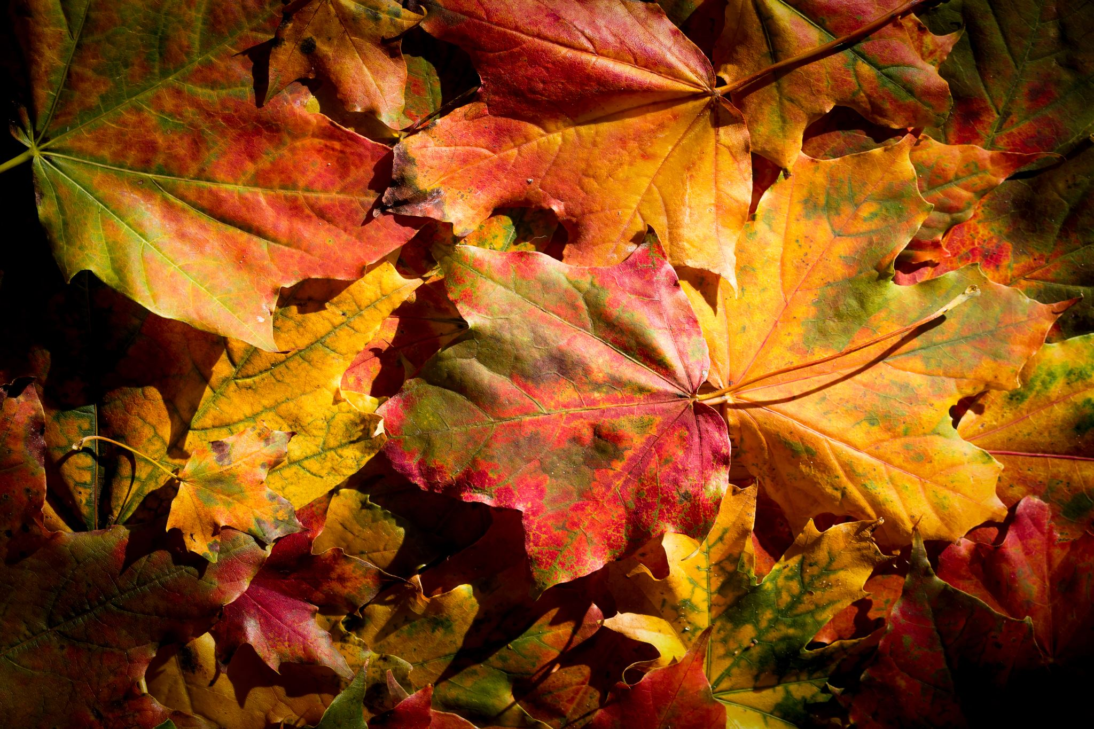
Miracle Plays
"A medieval dramatic form dealing with religious subjects such as Biblical stories or saints' lives, usually presented in a series or cycle by the craft guilds”
"A medieval play based on a biblical story or the life of a saint". In short miracle mean "a miracle is an event or occurrence which goes against the law of nature 10th to the 16th century.
Early Miracle plays are divided in to two parts :- (1) The Christmas play (2) The Easter play

Slide 3
Morality plays
An allegorical play popular especially in the 15th and 16th centuries in which the characters personify abstract qualities or concepts, such as virtues, vices, or death.
Something which involves a direct conflict between right and wrong or good and evil and from which a moral lesson may be drawn
MORALITY PLAYS—Teaches right and wrong; Allegories of Satan and God battling over our souls; Allegories of abstract qualities
﻿Famous morality plays: Robin Hood & Everyman

Slide 4

Morality Plays: Themes
1. Man begins in innocence
2. Man falls into temptation
3. Man repents and is saved.
The central action is the struggle of Man against the seven deadly sins that are personified into real characters
It is believed that the allegory of vices and virtues fighting over Man's soul goes back to the 4th century Roman epic,
The allegorical application of theatre to Christianity is intended to help the audience understand sin and virtue

Slide 5
Examples of Miracle and Morality plays:
1) Everyman
2) The King Lear
3) Doctor Faustus
4) Robin Hood

Slide 6
Difference between Mystery and Morality plays
Morality plays taught lessons of morality using allegorical char.acters
Mystery plays told stories from the Bible and gave way to large mystery cycles in which many stories were told sequentially on the same day.

Slide 7
INTERLUDE
An intervening episode, period, space, etc. a short dramatic piece, especially of a light or farcical character, formerly introduced between the parts or acts of miracle and morality plays or given as part of other entertainments.
Interludes were performed at court or at “great houses” by professional minstrels or amateurs at intervals between some other entertainment, such as a banquet, or preceding or following a play, or between acts.

Slide 8

Puritan literature
Puritan literature relied on a religious, rather than an entertainment, theme. Puritans didn't believe in writing for entertainment; rather, they thought of writing as a tool to reach people with the story of God.
The Puritans believed God had chosen a few people, "the elect," for salvation. The rest of humanity was condemned to eternal damnation. But no one really knew if he or she was saved or damned; Puritans lived in a constant state of spiritual anxiety, searching for signs of God's favor or anger.

Slide 9

The
Puritan movement
In England, the Puritan movement was initially led by figures such as William Tyndale, who translated the Bible into English, and Thomas Cranmer, the Archbishop of Canterbury who helped draft the Book of Common Prayer. However, the movement gained momentum under the leadership of non-conformist clergymen such as John Hooper, John Knox, and John Bradford, who advocated for further reforms within the Church of England.

Slide 10
The Bible
The Puritans believed that the Bible was the sole source of religious authority. The Bible was the inspired word of God and it contained all that was necessary for salvation. They rejected the authority of the Church of England and other religious institutions, believing that only the Bible could provide guidance for Christian living.

Slide 11

THANK YOU

