Slide 1
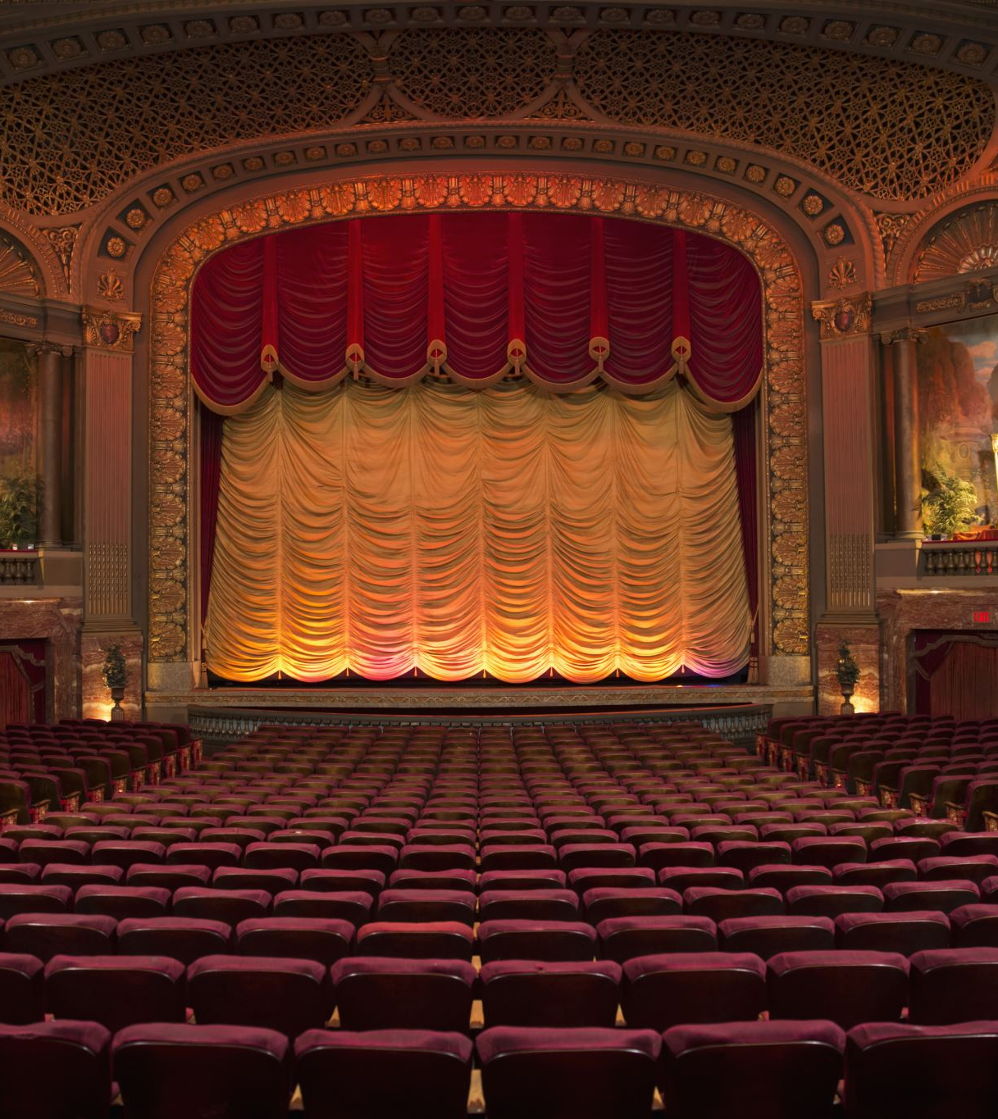

Interlude in British Drama
An Overview of Early English Theatrical Forms

Slide 2
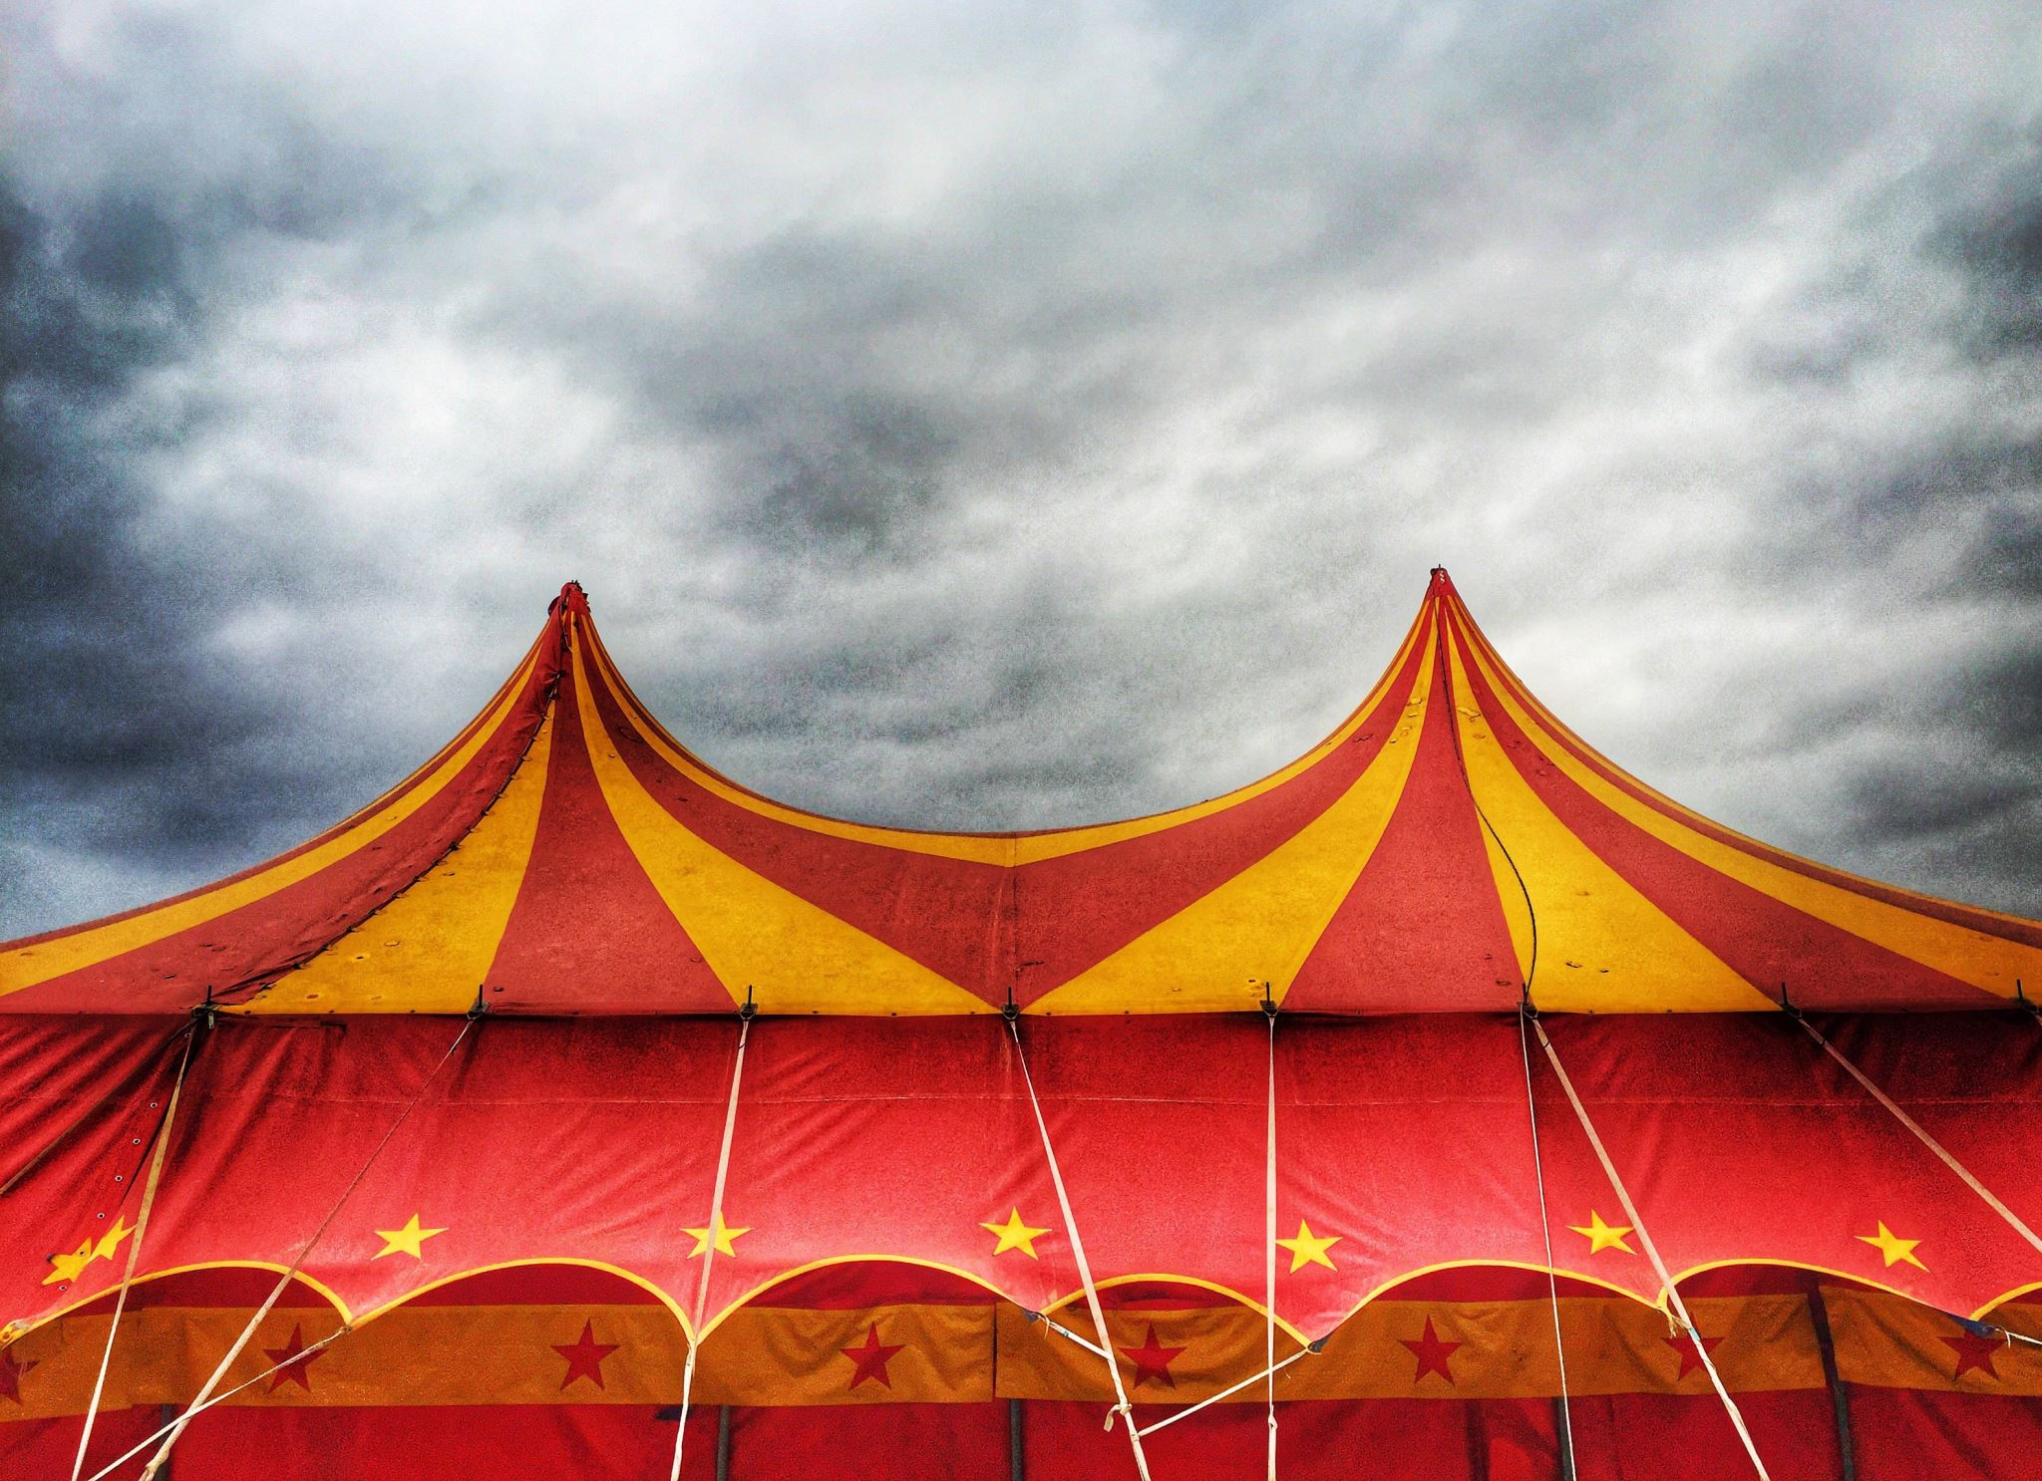

Introduction to Interludes
Definition:
Interludes were short theatrical entertainments performed during banquets or special occasions, especially between the main courses of a meal, hence the term interlude.
Popular in England during the late 15th and early 16th centuries.
Purpose:
Primarily for amusement, but often contained didactic or moral elements.

Slide 3

Historical Context
Time Period:
Interludes emerged in the late Middle Ages and became prominent during the Tudor period.(1485-1603)
Religious Influence:
Developed during a time when religious and morality plays were dominant in medieval England.
Transitioned from religious themes to secular entertainment.

Slide 4
Characteristics of Interludes
Short Performances:
Lasted around 15-30 minutes.
Limited Cast:
Performed by small troupes, usually 3-4 actors.
Flexible
Locations:
Could be performed in courts, homes, or inns.
Didactic Themes:
Often used allegory and humor to convey moral or political messages.

Slide 5

Famous Interlude Writers
John Heywood:
Known as one of the most famous interlude writers.
Works include The Play of the Weather and The Four P’s.
Henry Medwall:
Author of Fulgens and Lucrece, one of the earliest known interludes.

Slide 6

Significance in British Drama
Bridging the Gap:
Interludes served as a transitional form between the medieval morality plays and the more complex Renaissance drama.
Social Commentary:
Often used to subtly criticize or satirize contemporary politics and social structures.

Slide 7
Themes in Interludes
Morality and Religion:
Continuing the tradition of medieval morality plays.
Politics and Satire:
Criticism of social and political situations, often through allegory.
Human Nature:
Examined human folly, greed, and the battle between virtues and vices.

Slide 8
Influence on Later British Drama
Shakespearean Influence:
Shakespeare’s Comedy of Errors and other early works were influenced by the comic elements of interludes.
Secularization of Drama:
Helped move drama away from purely religious themes toward more human-centered stories and humor.

Slide 9
Conclusion
Legacy of Interludes:
Though short-lived as a popular form, interludes were crucial in developing British drama.
They provided the foundation for the more sophisticated Elizabethan and Jacobean theatre that followed.

