Slide 1

The Reformation
AND
English Literature
Introduction to the Reformation
Definition: The Reformation was a religious reform movement that swept through Europe in the 16th century, resulting in the creation of Protestant churches.
Impact in England: Initiation of the Church of England and significant religious, political, and cultural change.

Slide 2
KEY FIGURES
MARTIN LUTHER (1483-1546)
JOHN CALVIN (1509-1564)
HENRY VIII (1491-1547)

Slide 3

MARTIN LUTHER (1483-1546)

Slide 4
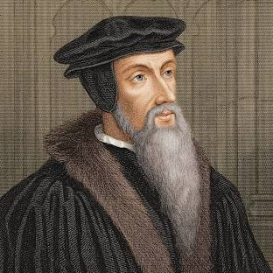
John Calvin (1509-1564)

Slide 5
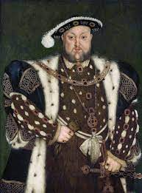
Henry VIII (1491-1547)

Slide 6

Causes of the Reformation
Corruption within the Church: Issues like indulgences and moral decay of clergy.
Printing Press Revolution: Spread of ideas challenging papal authority.
Humanism: Renaissance humanism fostered critical thinking and questioning of religious dogma.

Slide 7
Key Changes Brought by the Reformation
Religious Reforms: Establishment of Protestantism and changes in church structure.
Shift in Power: Reduced power of the Catholic Church over states.
Cultural Influence: Rise of literacy and questioning of authoritative texts.

Slide 8
The Reformation's Impact on English Literature
Vernacular Bible Translations: Enabled wider audience access, beginning with William Tyndale's translations.
Themes in Literature: Rise of religious themes focused on individual faith, morality, and ecclesiastical critique.
Proliferation of Public Discourse: Pamphlets and tracts became important for political and religious discourse.

Slide 9
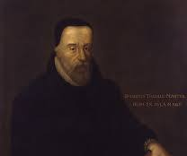
Notable Literary Figures
William Tyndale:
(c1494 –1536)
Translation of the Bible into English, influencing religious texts' accessibility.

Slide 10
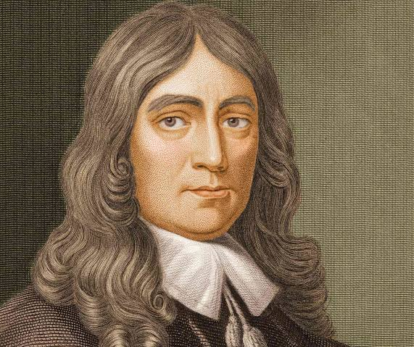
JOHN MILTON
(1608-1674)
"Paradise Lost," intertwines religious themes reflecting on fall and redemption.

Slide 11
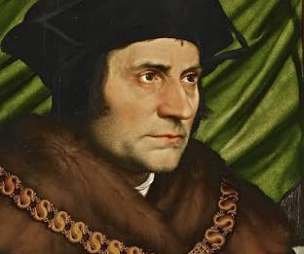
Thomas More
(1478-1535)
Thomas More: “Utopia,” questions the morality and practices of the time.

Slide 12
Literary Forms Influenced by the Reformation
Pamphlets and Propaganda: Crucial in disseminating and debating reform ideas.
Sermons and Essays: Emerged as a way to explore theological and moral queries.
Plays and Poetry: Embedded with reformation ideology, often challenging traditional authority.

Slide 13
Example: John Foxe's "Book of Martyrs"
Overview: Chronicles persecution of Protestant reformers; powerful tool for Protestant identity.
Impact: Widely read, informing public sentiment and demonstrating religious conviction against Catholicism.

Slide 14
Long-term Effects on English Literature
Growth of Secular Literature: Encouragement of personal interpretation leading to more secular themes.
Acknowledgment of Different Perspectives: Opened doors to socially and politically diverse dialogue.
Foundation for Modern Literature: Encouraged questioning philosophy, paving the way for Enlightenment thinking.

Slide 15
Conclusion
The Reformation played a critical role in transitioning English literature from medieval to modern narrative forms by promoting literacy, encouraging secular themes, and fostering diverse religious and philosophical writings.
Its legacy is seen in the proliferation of religious tolerance and critical engagement with authoritative concepts within literature.

