Slide 1

Dream Allegory
Dream Allegory, also known as Dream Vision, is a literary genre in which the narrative is framed as the recounting of a dream or vision experienced by the protagonist or narrator. The dream usually serves as an allegorical representation of complex themes, moral dilemmas, or philosophical questions. It was particularly popular during the medieval period, but its influence is seen in many forms of literature throughout history.

Slide 2

Dream as a Narrative Form
The story often begins with the narrator falling asleep and entering a dream state. The events of the dream then unfold as the main plot. When the narrator wakes, the story usually concludes with a reflection on the dream's meaning or significance. The dream provides a structural framework, often blurring the lines between reality and the fantastical.

Slide 3

Allegorical Nature
The dream itself is not just a literal recounting of events but a symbolic journey filled with metaphorical meanings. Characters in the dream often represent abstract concepts such as virtue, sin, knowledge, or love. Events and settings in the dream are typically charged with multiple layers of interpretation, inviting the reader to discern the underlying moral or philosophical lessons.

Slide 4

Moral or Philosophical Messages
Dream allegories typically aim to teach or explore deep moral or philosophical questions. The dream format allows for a more flexible and imaginative exploration of these themes, free from the constraints of everyday reality. It is a way to delve into profound truths without being too didactic, often using surreal and symbolic events to convey complex ideas.

Slide 5

Interaction with Supernatural Beings or Forces
In many dream allegories, the narrator encounters supernatural or otherworldly figures, such as gods, spirits, or personifications of abstract ideas (e.g., Truth, Death, Fortune). These figures act as guides or antagonists in the dream and help illuminate the moral or spiritual lessons of the narrative.

Slide 6

Reflection on Reality
Upon waking, the dreamer often reflects on the dream’s meaning, offering a more concrete interpretation of the events. This reflection serves as a bridge between the allegorical world of the dream and the reader’s understanding of the real world, making the lesson more tangible.

Slide 7
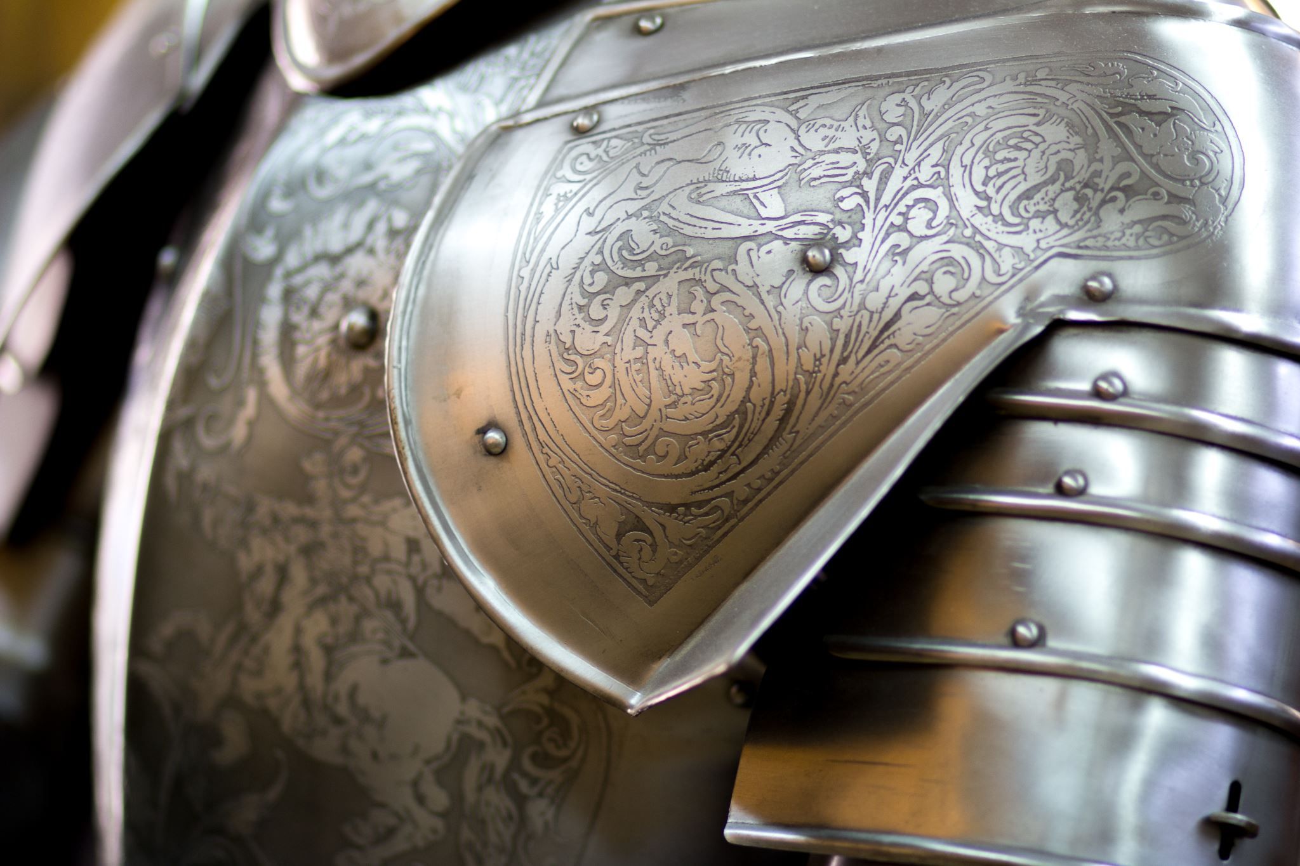
Medieval Literature
The dream allegory genre flourished during the Middle Ages in Europe, particularly from the 12th to the 15th centuries. During this period, it was common for authors to present their stories as dreams or visions. Medieval writers used this genre to explore religious, ethical, and political themes.

Slide 8


Famous examples of medieval dream allegory
One of the most famous examples of a medieval dream allegory is The Divine Comedy by Dante Alighieri, where the protagonist, Dante, embarks on an allegorical journey through Hell, Purgatory, and Heaven. The entire narrative can be seen as a visionary dream representing the soul's journey toward salvation.
Another key work is The Dream of the Rood, an Old English poem in which the narrator dreams of the Cross (Rood) speaking to him about Christ’s crucifixion, symbolizing redemption and spiritual growth.

Slide 9

The Romance of the Rose
A famous medieval French allegory, The Romance of the Rose is a dream narrative where the dreamer embarks on a journey to win the love of a symbolic rose. The rose represents various aspects of love, desire, and courtship. The work shifts from a romantic, courtly love story to a more philosophical and satirical exploration of human emotions and moral questions.

Slide 10

Piers Plowman by William Langland
This 14th-century English dream allegory presents a series of visions experienced by the narrator, often named Will. The visions are rich with symbolic imagery, addressing themes like social justice, spiritual truth, and moral integrity. The dream structure allows Langland to critique the corrupt institutions of his time while presenting a spiritual journey toward salvation.

Slide 11

The Pilgrim’s Progress by John Bunyan
Written in the 17th century, The Pilgrim’s Progress is a Christian allegory structured as a dream. The protagonist, Christian, journeys from his hometown to the Celestial City, symbolizing the spiritual path of a believer seeking salvation. The dream format allows Bunyan to explore complex theological concepts through vivid, imaginative scenes.

Slide 12

KUBLA KHAN by
Samuel Taylor Coleridge
Although not a full-fledged narrative dream allegory, Coleridge’s Kubla Khan is a famous poem that came to the poet in a dream-like vision. The poem's rich, surreal imagery and its exploration of the creative imagination reflect the Romantic era’s fascination with dreams as sources of inspiration and insight.

Slide 13

Themes Commonly Explored in Dream Allegories
Moral Redemption: Many dream allegories centre around the soul’s journey toward moral or spiritual redemption. This often involves the protagonist encountering various temptations, trials, or symbolic figures that represent virtues and vices.

Slide 14

The Fragility of Human Life
Dream allegories often highlight the transitory nature of human existence. The dream format is ideal for showing how fleeting and illusory worldly concerns can be, with dreams symbolizing the temporary nature of life itself.

Slide 15

Search for Truth
Dreams are frequently used to represent the quest for knowledge and truth, whether it be spiritual, moral, or philosophical. The dreamer’s journey is often one of enlightenment, with each encounter and event leading them closer to a deeper understanding.

Slide 16

Conclusion
Dream allegories serve as an intricate form of storytelling that enables writers to explore abstract concepts and human emotions through symbolic, fantastical narratives. By presenting a dream as the main setting, authors can delve into the subconscious, morality, and metaphysical ideas in a way that transcends the limits of straightforward narrative realism. These works often invite readers to interpret the layers of meaning within the dream, creating a rich, thought-provoking experience.

