Slide 1
The Colour Purple: Themes: Oppression and Abuse (Racism and Sexism)
Racism: In addition to the gender-based oppression, the novel portrays the racial discrimination experienced by African American characters in the American South. Although the theme of racism is not as pronounced as sexism, it is deeply interwoven into the characters' lives, especially in the way black men and women are marginalized, economically exploited, and denied basic human rights. Nettie’s letters about her experiences with racism as a missionary in Africa also reflect the global impact of colonialism and racial subjugation.

Slide 2
Oppression and Abuse (Racism and Sexism)
Sexual and Domestic Abuse: At the heart of Celie’s story is the harrowing abuse she suffers at the hands of the men in her life. From a young age, Celie is sexually abused by her stepfather, and later, she enters into a violent marriage with Mister. These relationships reflect the broader theme of patriarchal oppression, where women are treated as property or objects rather than as equals.

Slide 3
Violence and Female Solidarity
Throughout the novel, the male characters, especially Mister and Celie’s stepfather, are portrayed as products of a system that normalizes violence against women. This cycle of violence, passed down through generations, demonstrates how systemic sexism breeds toxic masculinity and perpetuates female subjugation.
However, the novel counters this violence with examples of female solidarity and sisterhood. Characters like Shug Avery, Sofia, and Nettie play critical roles in Celie’s journey to self-realization. The bonds of sisterhood and friendship are a crucial lifeline for many of the female characters, providing them with the emotional strength to survive and ultimately thrive.

Slide 4
Empowerment and Identity
One of the most profound themes in the novel is Celie’s journey of empowerment. However, as she develops relationships with stronger, more independent women like Shug Avery, she begins to reclaim her identity and voice.
Celie’s growth is closely tied to her ability to assert herself, express her emotions, and break away from the abusive men in her life. Through Shug’s influence, Celie discovers the pleasure and power of her own body, an important step toward reclaiming her sense of agency. Eventually, Celie gains financial independence by starting her own business, sewing pants for women. This newfound economic and emotional self-sufficiency marks her full transformation from victim to empowered woman.

Slide 5
Sexuality and Gender Roles
The Color Purple also challenges traditional notions of sexuality and gender. Celie’s relationship with Shug Avery is a key element in this regard. Shug helps Celie explore her own sexual identity, and their relationship becomes a source of profound emotional and sexual awakening for Celie. This same-sex relationship is portrayed in a positive light, which was ground-breaking for the time the novel was written.
Additionally, the novel questions conventional gender roles. Sofia, who refuses to submit to her husband Harpo or any man, embodies strength and independence in defiance of patriarchal expectations. Harpo’s attempts to control Sofia fail, and eventually, he learns that equality in marriage is necessary for love to thrive.

Slide 6
Religious and Spiritual Exploration
Celie’s relationship with God is another significant theme in the novel.
Her letters to God are initially a way of confiding her pain, as she has no one else to turn to. Celie’s understanding of God evolves, especially under Shug’s influence. Shug introduces her to a more pantheistic, spiritual view of God. This shift allows Celie to break free from the confines of traditional religion, finding God in herself and the world around her. This spiritual transformation is deeply tied to her emotional and psychological empowerment.

Slide 7
The Role of Letters and Communication
The epistolary format of the novel, consists of letters written by Celie and later by Nettie, emphasizes the importance of communication in personal growth and connection. It expresses an act of self-expression for Celie, helping to process her emotions, understand her experiences, and find her voice. The letters between Celie and Nettie also represent the power of human connection and the endurance of love despite physical distance. Nettie’s letters to Celie, keep on reminding her that she is loved and valued.

Slide 8
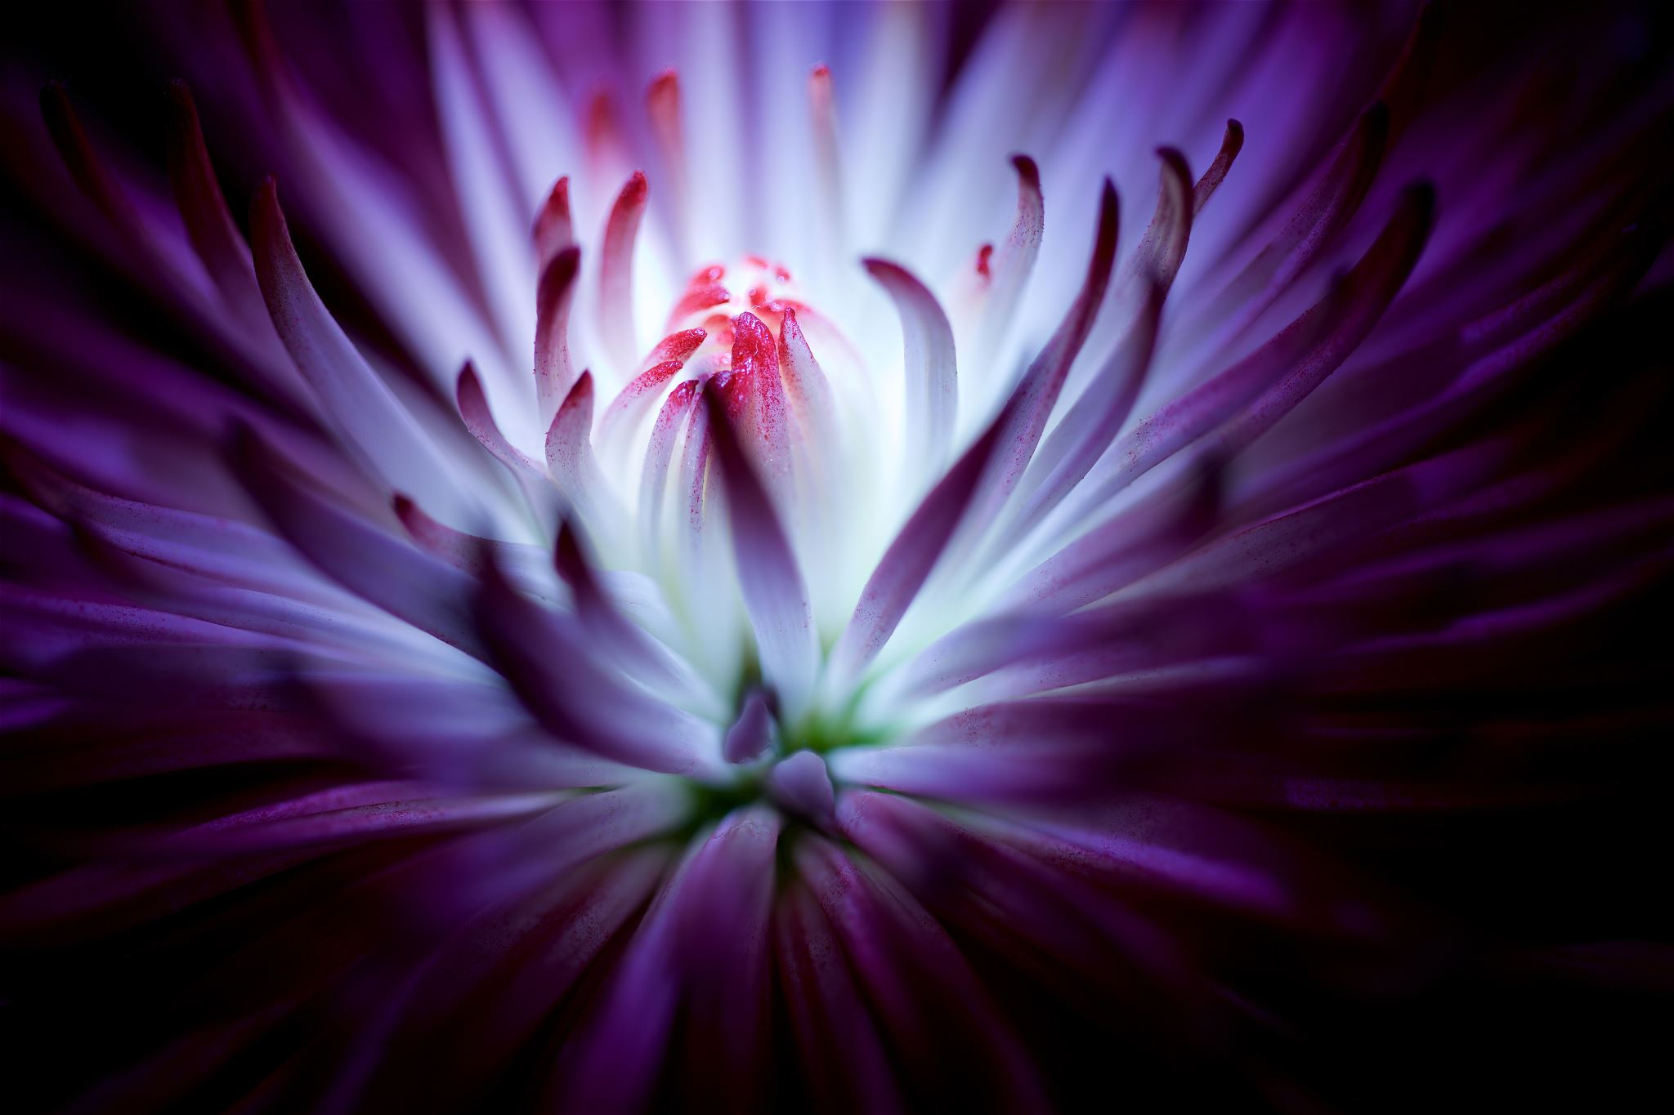
The Meaning of the colour Purple
The novel’s title, The Colour Purple, is itself symbolic. It represents the beauty and wonder of life, often overlooked in the characters' struggles and hardships. The color symbolizes the divine presence in everyday life.The color purple also symbolizes transformation and royalty. As Celie evolves from a powerless girl to an empowered woman, she embodies this sense of royalty and self-worth, much like the color purple, which historically has been associated with nobility and greatness.

Slide 9
Transformation and Forgiveness
One of the most touching aspects of the novel is its message of forgiveness and personal transformation. By the end, Celie forgives the men who abused her, particularly Mister. Mister himself undergoes a transformation, realizing the wrongs he committed. This shift reflects a larger theme of human growth and the potential for change, even in the most damaged relationships.
Celie also forgives her stepfather after learning that he is not her biological father. Forgiveness, in this context, is portrayed as a crucial part of Celie’s healing and liberation.

Slide 10
CONCLUSION
The Color Purple is a profound exploration of oppression, identity, and the resilience of the human spirit.
The novel's intersectional approach to themes of race, gender, and class makes it a timeless work of literature, celebrating the ability of individuals—particularly marginalized women. The novel’s ultimate message is of hope, emphasizing that even in the darkest of circumstances, beauty, joy, and empowerment can be found.

