Slide 1
Introduction to Tensors
Part III
Coordinate Transformation
Deepshikha Gogoi

Slide 2
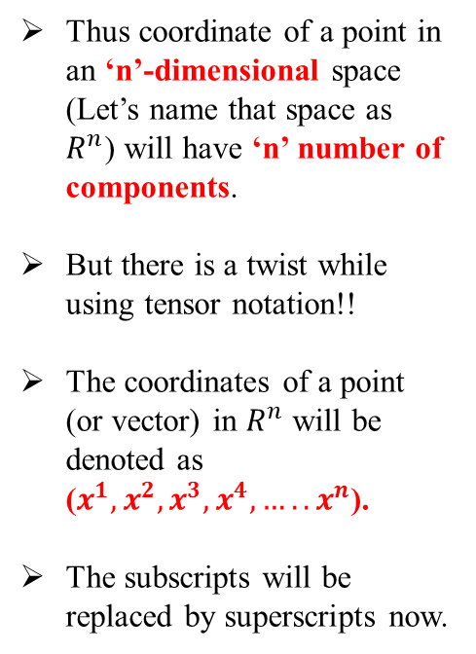
Coordinate Systems:
2D Cartesian Coordinate
Two components- x and y
In general: $x_{1}=x,$
$$x_{2}=y$$
In general: 𝒙_𝟏=𝒙,
𝒙_𝟐=𝒚
3D Cartesian Coordinate
Three components- x, y and z
In general: $x_{1}=x,$
$$x_{2}=y$$
$$x_{3}=z$$
In general: 𝒙_𝟏=𝒙,
𝒙_𝟐=𝒚
𝒙_𝟑=𝒛
Thus coordinate of a point in an ‘n’-dimensional space (Let’s name that space as $R^{n}$) will have ‘n’ number of components.
But there is a twist while using tensor notation!!
The coordinates of a point (or vector) in $R^{n}$ will be denoted as ($x^{1},x^{2},x^{3},x^{4},…..x^{n}$).
The subscripts will be replaced by superscripts now.

Slide 3

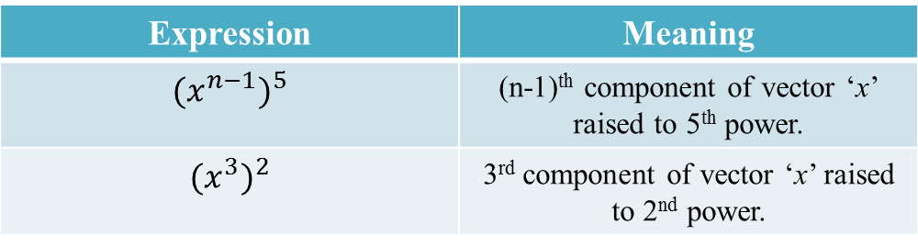
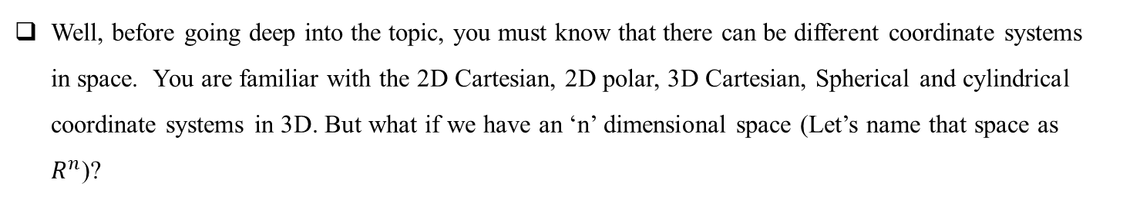
If a power of some vector component is to be indicated then brackets or parentheses are thus needed
Expression | Meaning
$${(x^{n−1})}^{5}$$ | (n-1)^{th} component of vector ‘x’ raised to 5th power.
$${(x^{3})}^{2}$$ | 3rd component of vector ‘x’ raised to 2nd power.
If I ask you the meaning of $U^{3}$ and I am not defining whether U is a vector or scalar or any real number, then what will you interpret?
Well, before going deep into the topic, you must know that there can be different coordinate systems in space. You are familiar with the 2D Cartesian, 2D polar, 3D Cartesian, Spherical and cylindrical coordinate systems in 3D. But what if we have an ‘n’ dimensional space (Let’s name that space as $R^{n}$)?

Slide 4
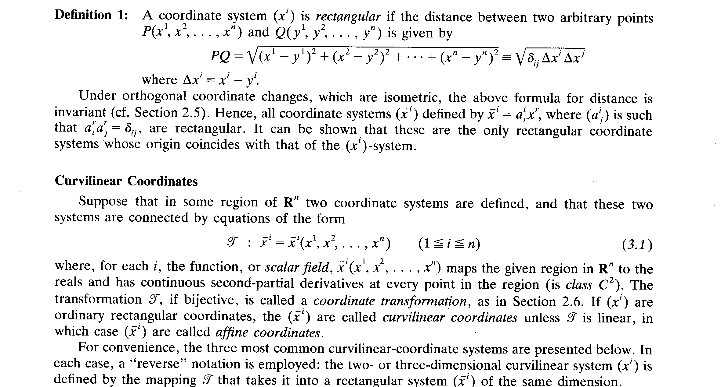
Coordinate transformation:

Slide 5
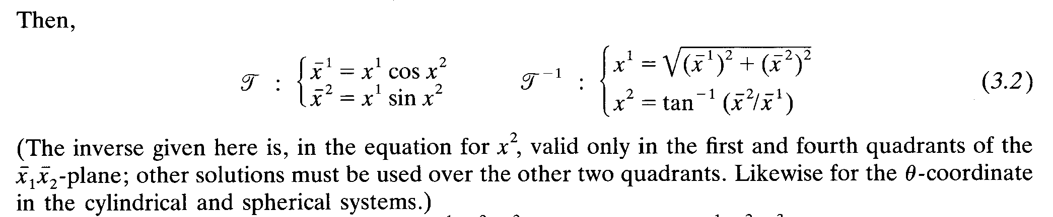
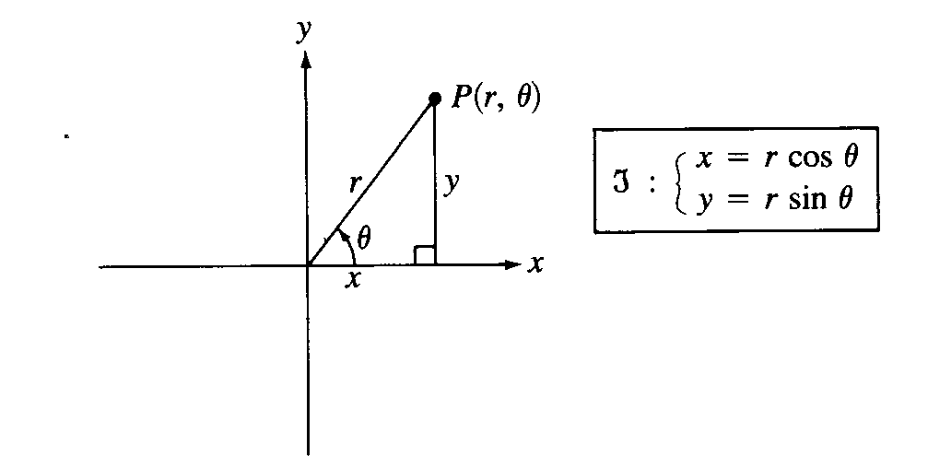
Polar coordinates: If (${\overline{x}}^{1},{\overline{x}}^{2}$) = (x, y) and ($x^{1},x^{2}$) = (r, $θ$) then
Here, Ʈ is bijective
It is non-linear
It has continuous 2nd order partial derivative
Thus polar coordinates are curvilinear coordinates

Slide 6
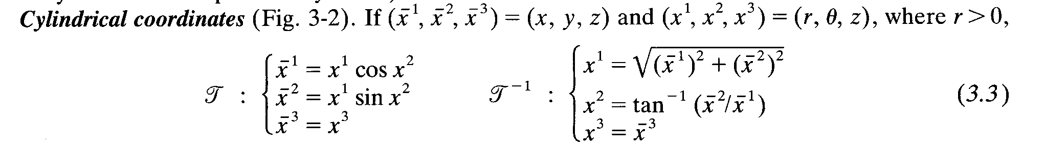
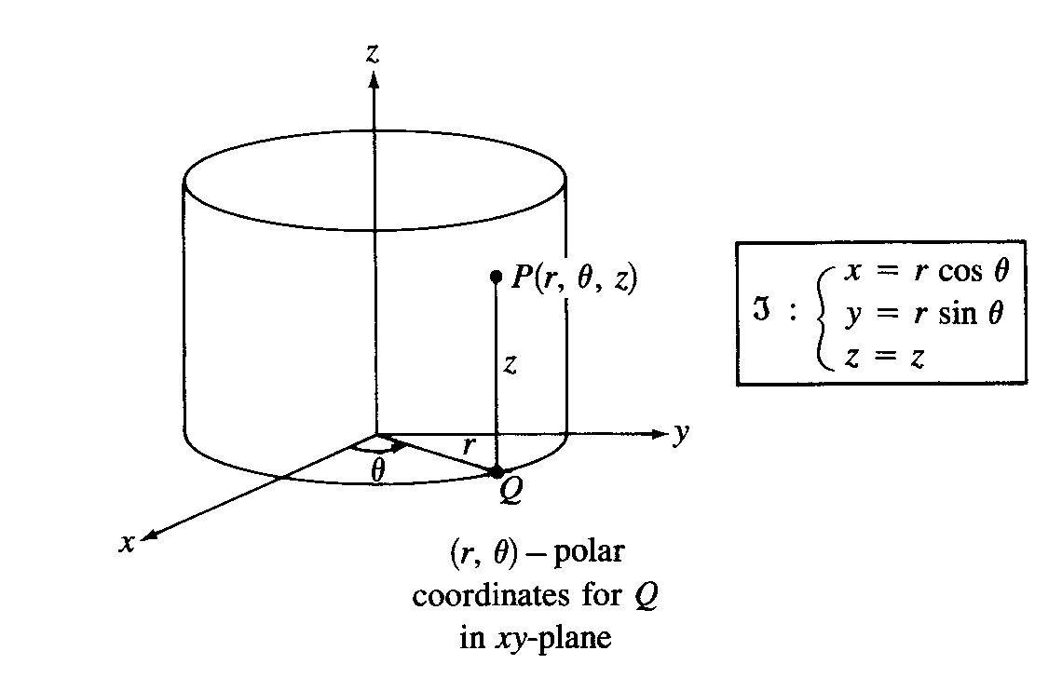

Slide 7
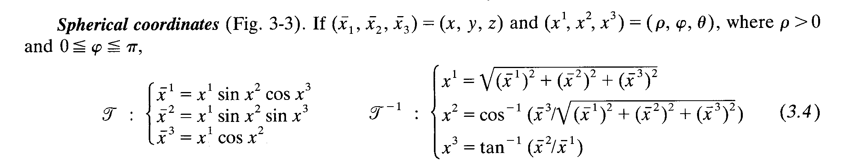
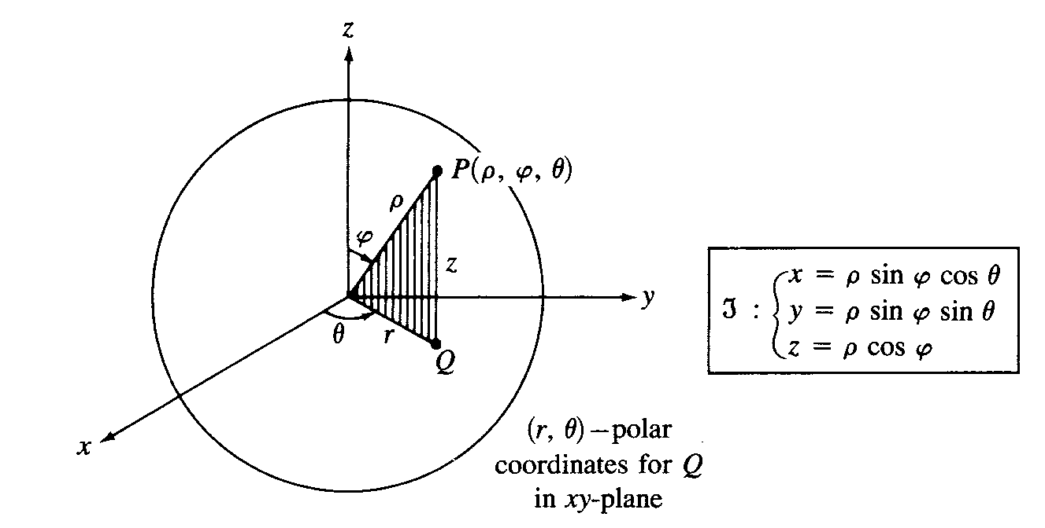

Slide 8
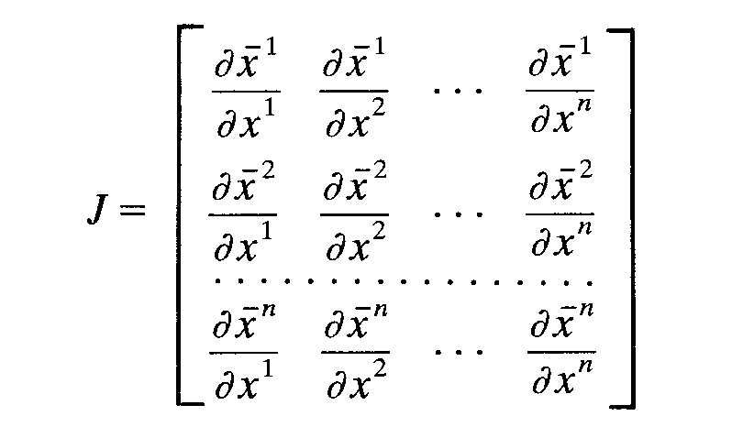
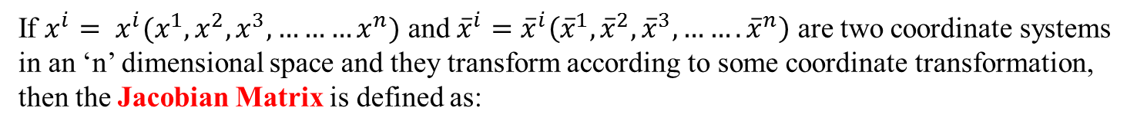
The Jacobian:
If $x^{i}= x^{i}(x^{1},x^{2},x^{3},………x^{n})$ and ${\overline{x}}^{i}={\overline{x}}^{i}\left({\overline{x}}^{1},{\overline{x}}^{2},{\overline{x}}^{3},…….{\overline{x}}^{n}\right)$ are two coordinate systems in an ‘n’ dimensional space and they transform according to some coordinate transformation, then the Jacobian Matrix is defined as:
The determinant of the Jacobian matrix is known as the Jacobian

Slide 9
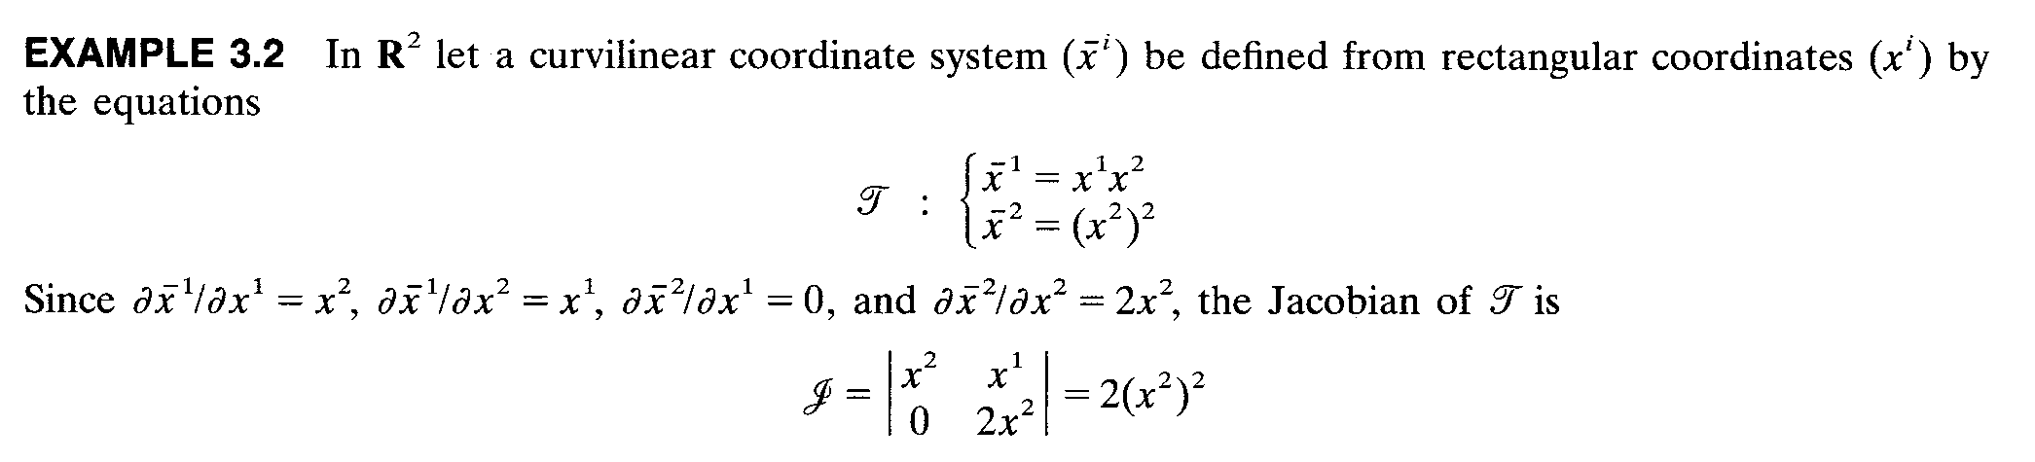
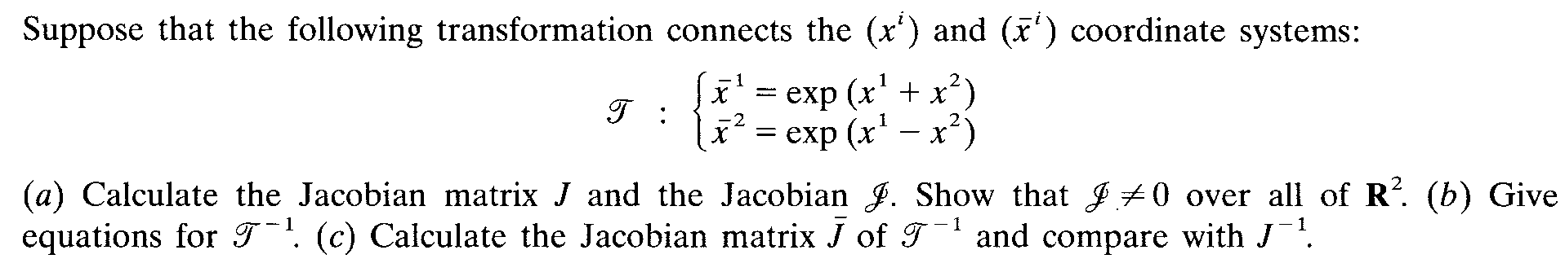
PROBLEM

Slide 11
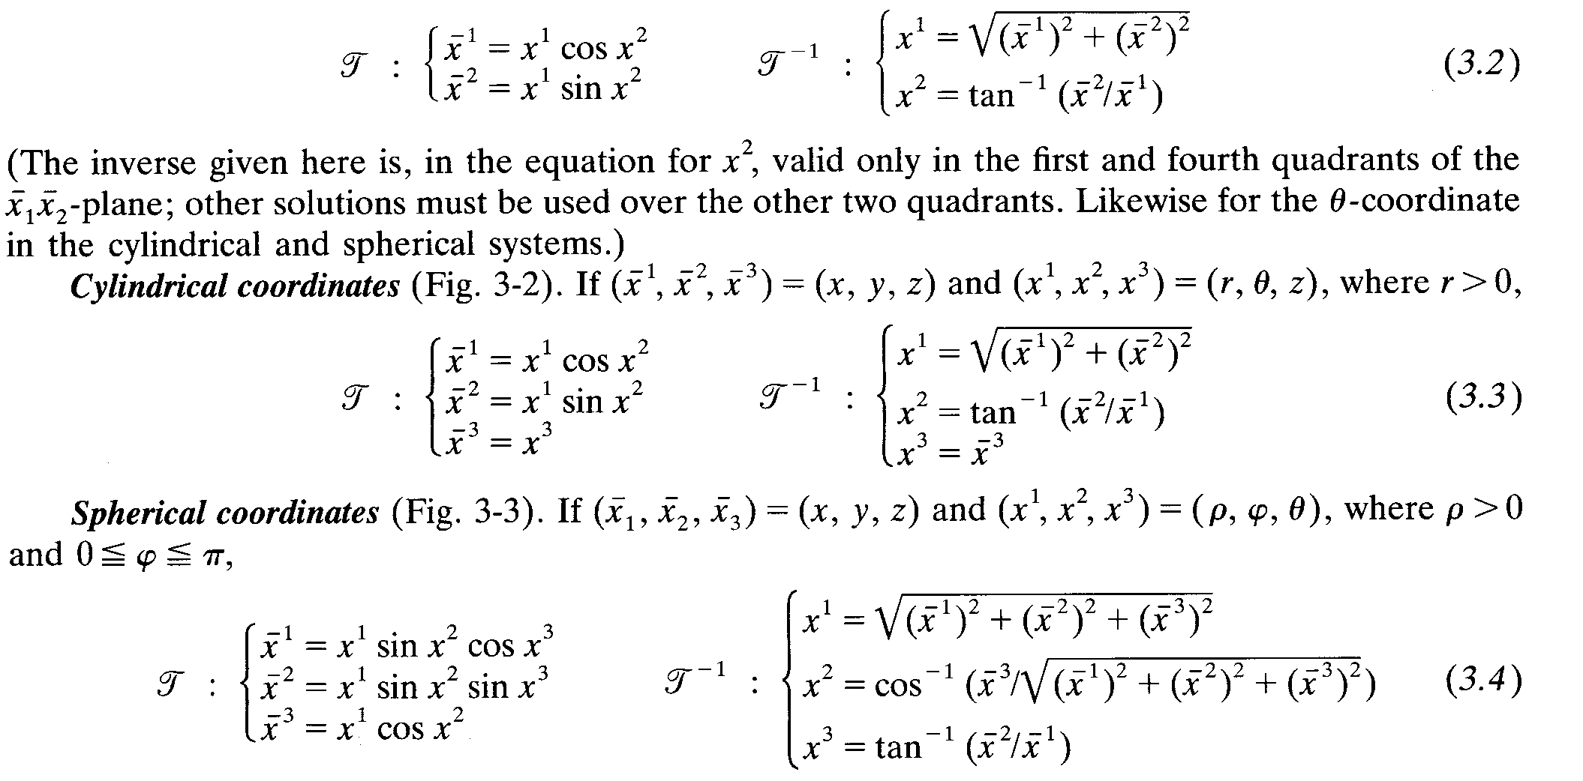
Polar coordinates: If (${\overline{x}}^{1},{\overline{x}}^{2}$) = (x, y) and ($x^{1},x^{2}$) = (r, $θ$) then

