Slide 1
Introduction to Tensors
Part II
Deepshikha Gogoi

Slide 2
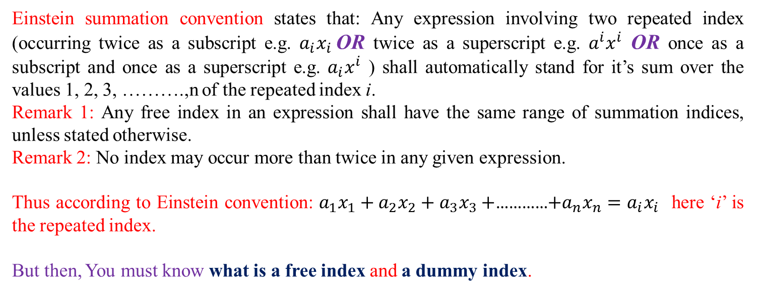
Einstein Summation Convention:
Conventional way of presenting summations:
$a_{1}x_{1}+a_{2}x_{2}+a_{3}x_{3}+$…………$+a_{n}x_{n}=∑a_{i}x_{i}$ where the index ‘i’ varies from 1 to n.
Einstein summation convention states that: Any expression involving two repeated index (occurring twice as a subscript e.g. $a_{i}x_{i}$OR twice as a superscript e.g. $a^{i}x^{i}$ OR once as a subscript and once as a superscript e.g. $a_{i}x^{i}$ ) shall automatically stand for it’s sum over the values 1, 2, 3, ……….,n of the repeated index i.
Remark 1: Any free index in an expression shall have the same range of summation indices, unless stated otherwise.
Remark 2: No index may occur more than twice in any given expression.
Thus according to Einstein convention: $a_{1}x_{1}+a_{2}x_{2}+a_{3}x_{3}+$…………$+a_{n}x_{n}=a_{i}x_{i}$ here ‘i’ is the repeated index.
But then, You must know what is a free index and a dummy index.

Slide 3

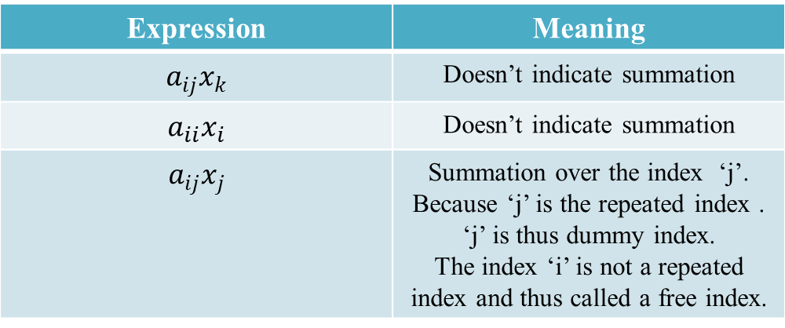
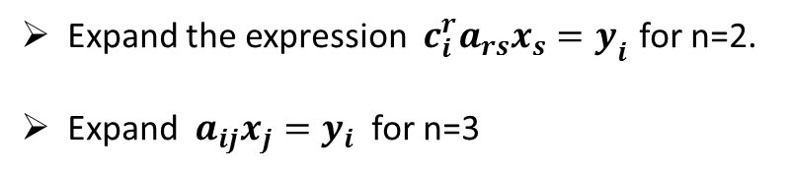
Free Index and Dummy Index:
Expression | Meaning
$$a_{ij}x_{k}$$ | Doesn’t indicate summation
$$a_{ii}x_{i}$$ | Doesn’t indicate summation
$$a_{ij}x_{j}$$ | Summation over the index ‘j’. Because ‘j’ is the repeated index . ‘j’ is thus dummy index. The index ‘i’ is not a repeated index and thus called a free index.
Thus $a_{ij}x_{j}≠a_{kj}x_{j}$ unless i=k
Try these
Expand the expression $c_{i}^{r}a_{rs}x_{s}=y_{i}$ for n=2.
Expand $a_{ij}x_{j}=y_{i}$ for n=3

Slide 4
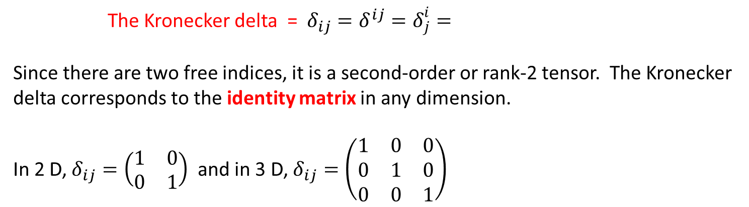
Kronecker Delta:
The Kronecker delta = $δ_{ij}=δ^{ij}=δ_{j}^{i}=$
Since there are two free indices, it is a second-order or rank-2 tensor. The Kronecker delta corresponds to the identity matrix in any dimension.
In 2 D, $δ_{ij}=\left(\begin{matrix}1 & 0 \\ 0 & 1\end{matrix}\right)$ and in 3 D, $δ_{ij}=\left(\begin{matrix}1 & 0 & 0 \\ 0 & 1 & 0 \\ 0 & 0 & 1\end{matrix}\right)$
Levi-Civita tensor:
cycle clockwise: 1,2,3; or 2,3,1; or 3,1,2
cycle counterclockwise: 1,3,2; or 3,2,1; or 2,1,3
otherwise

Slide 5
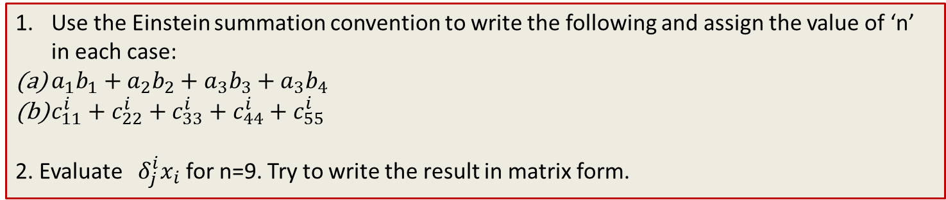
Try these
Use the Einstein summation convention to write the following and assign the value of ‘n’ in each case:
$a_{1}b_{1}+a_{2}b_{2}+a_{3}b_{3}+a_{3}b_{4}$
$c_{11}^{i}+c_{22}^{i}+c_{33}^{i}+c_{44}^{i}+c_{55}^{i}$
2. Evaluate ${ δ}_{j}^{i}x_{i}$ for n=9. Try to write the result in matrix form.
Indices are the utmost important things in Tensor
You just have to play around the indices to use tensors properly

