Slide 1
Introduction to Tensors
Dr Deepshikha Gogoi

Slide 2
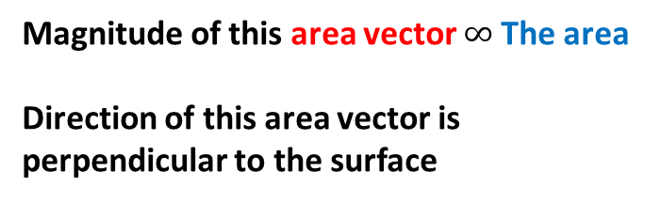
The best way to understand a tensor is to begin by making sure that you are solid on your understanding of vectors.
Vector is generally viewed as
But vectors can represent other things too, such as an area.
Z
Magnitude of this area vector $∞$The area
Direction of this area vector is perpendicular to the surface
X
Y

Slide 3
Thus we can say that vectors are members of wider class of objects called tensors.
But then, you must have a better understanding of vector components and basis vectors
Let denote unit vectors in the x, y and z direction. The hat denotes a magnitude of unity
The position vector (the arrow denotes a vector that is not a unit vector) is given as
X component
Basis vector for X component
This makes vector a tensor of Rank 1, which means it needs one basis vector per component

Slide 4
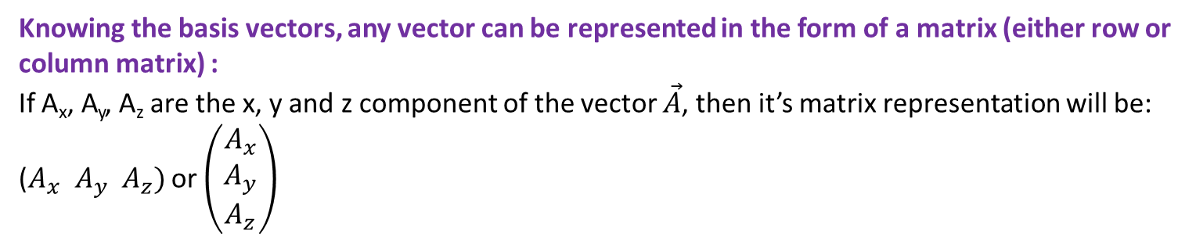
Some more examples of vectors with their component and basis vectors:
The velocity vector is given as
The acceleration vector is given as
Knowing the basis vectors, any vector can be represented in the form of a matrix (either row or column matrix) :
If A_{x}, A_{y}, A_{z} are the x, y and z component of the vector $\vec{A}$, then it’s matrix representation will be:
($A_{x} A_{y} A_{z})$ or $\left(\begin{matrix}A_{x} \\ A_{y} \\ A_{z}\end{matrix}\right)$

Slide 5
σ_{zz}
Stress vector: A higher rank tensor
Z
σ_{zx}
σ_{zy}
Consider the forces inside a solid object.
X
Y

Slide 6
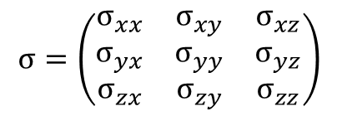
The force per unit face area acting in the z direction on that face is the stress σ_{zz} (first face, 2nd stress).
The forces per unit face area acting in the x and y directions on that face are the stresses σ_{zx} and σ_{zy}.
Here σ_{zz} is a normal stress (acts normal, or perpendicular to the face) and σ_{zx} and σ_{zy} are shear stresses (act parallel to the face).
Thus the stress tensor will have nine components. In matrix form, it can be written as:
$$σ=\left(\begin{matrix}σ_{xx} & σ_{xy} & σ_{xz} \\ σ_{yx} & σ_{yy} & σ_{yz} \\ σ_{zx} & σ_{zy} & σ_{zz}\end{matrix}\right)$$
Thus the stress tensor is an example of rank 2 tensor. Each of the nine components have two basis vectors. The number of subscripts in a component denotes the number of basis vectors it has.

Slide 7
You may be wondering what is about the combination of components and basis vectors that makes tensors so powerful!!!
The answer is: All observers, in all reference frames, agree not on the basis vectors OR not on the components BUT on the combination of components and basis vectors.
The reason for this is: The basis vectors transform in one way between reference frames, and the components transform in just such a way so as to keep the combination of components and basis vectors same for all observers.
It was this characteristics of tensors that caused people to call tensors “The facts of the universe!”

Slide 8
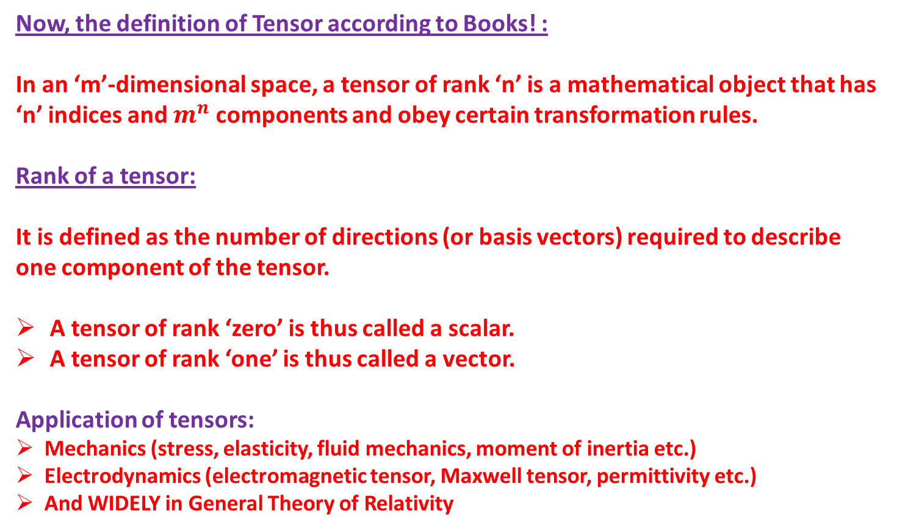
Now, the definition of Tensor according to Books! :
In an ‘m’-dimensional space, a tensor of rank ‘n’ is a mathematical object that has ‘n’ indices and $m^{n}$ components and obey certain transformation rules.
Rank of a tensor:
It is defined as the number of directions (or basis vectors) required to describe one component of the tensor.
A tensor of rank ‘zero’ is thus called a scalar.
A tensor of rank ‘one’ is thus called a vector.
Application of tensors:
Mechanics (stress, elasticity, fluid mechanics, moment of inertia etc.)
Electrodynamics (electromagnetic tensor, Maxwell tensor, permittivity etc.)
And WIDELY in General Theory of Relativity

