Slide 1

Introduction to Botany
Warm welcome to you all.
Good luck
Presented by:
Dr. Subrata Sarkar, MSc, MPhil, PhD
Phone: 9613627510
9365616158

Slide 2
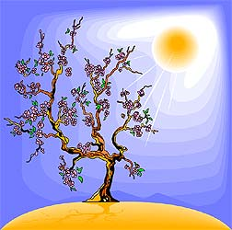
Botany-the Study of Plants
At the end you will be able answer
What is the original word of botany?
What are living things?
What are plants?
Difference plant and animal cells.
Divisions of plant kingdom.

Slide 3
Botany
Evolved from Greek word “Botane” meaning "pasture", "grass", or "fodder“-Herbs
Also called plant science(s), plant biology or phytology (Phyto= Plant)
Botany originated in prehistory as herbalism with the efforts of early humans to identify – and later cultivate – edible, medicinal and poisonous plants
They were forerunners of the first botanical gardens attached to universities, founded from the 1540s onwards.
One of the earliest was the Padua botanical garden.

Slide 4
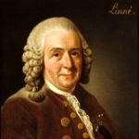
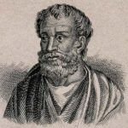
The Linnaean Garden of Linnaeus' (father of taxonomy) residence in Uppsala, Sweden, was planted according to his Systema sexuale
Theophrastus-father of Botany

Slide 5
Botany Today
Modern botany is a broad, multidisciplinary with inputs from most other areas of science and technology.
It includes the study of plant structure, growth and differentiation, reproduction, biochemistry and primary metabolism, chemical products, development, diseases, evolutionary relationships, systematics, and plant taxonomy.

Slide 6
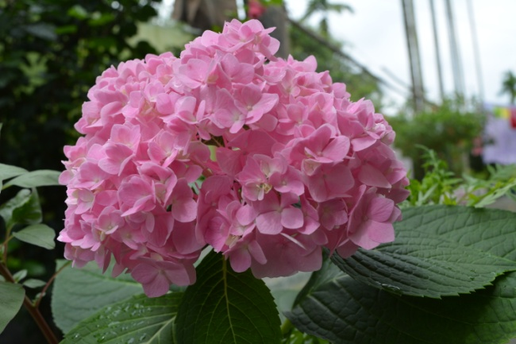
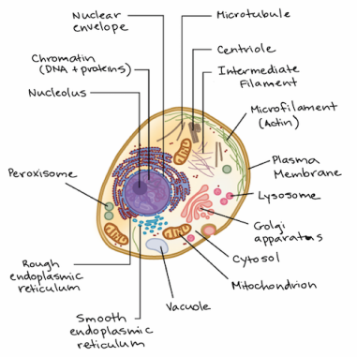
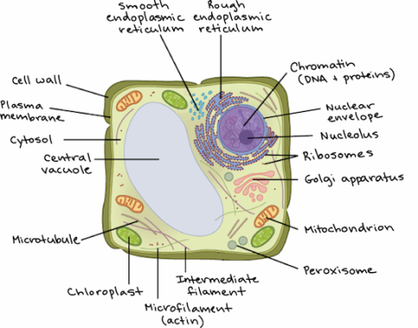
You will need an axe to fall a tree!
Living Things
Plants
Complete life processes or functions of life-
Nutrition
Growth and Development
Reproduce
Respiration
Response to environment and stimuli
These functions are done by Cells (prokaryotic/Eukaryotic) only
Cell wall
Chloroplasts
walls of plant cells comprises cellulose/chitin/peptido-glycan (glycoprotein) etc.

Slide 7
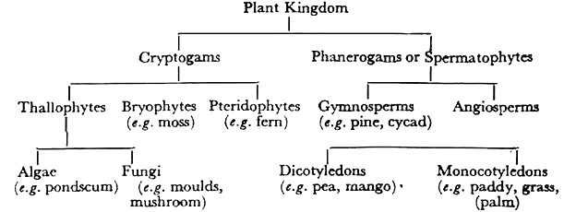
How many plant types?

Slide 8
Who is what?
Plants-living things having cell wall and chloroplast (fungi lacks chloroplasts).
Spermatophytes
Phanerogames-flowerng plants (seeded)
Angiosperms-plants having seeds remain hidden in fruits
  Gymnosperms-naked seeded plants; seed itself is fruit.
Cryptogames-non-flowering plants
  Thallophytes-plant body not divided into roots, stems and leaves (thalloid meaning thread-like)
    Phycophyta (algae)-clhloroplast present (autotrophic)
    Mycophyta (fungi)-chloroplast absent (parasite or saprophytes)
    Bryophytes-green land plants, root-like organs (rhizoids) present , gametohytic
    Pteridophyte-vascular and sporophytic plants

Slide 9
Invisible Plants
  Microbial Types-
  Viruses
  Bacteria
  Protozoans
  Fungi
  Algae
Microbes-organisms (living?) not visible by naked eyes.
    (Mikro=small;)
  Organisms having diameter of less than or equal to 1.0mm are designated as micro-organisms.
  Microbiology- study of microbes/microorganisms.

Slide 10
In next class we will discuss about Viruses and Bacteriabacteria

Slide 11
Thank You

